Slide 1

Actor-Critic Method
Actor-critic methods are still policy gradient methods.
They emphasize the structure that incorporates the policy gradient and value-based methods.
What are “actor” and “critic”?
Here, “actor” refers to policy update. It is called actor is because the policies will be applied to take actions.
Here, “critic” refers to policy evaluation or value estimation. It is called critic because it criticizes the policy by evaluating it.
Bellman 方程/Bellman最优方程 -> v(s),q(s,a) ➔ 评估当前策略
利用q(s,a) upgrade 策略 ➔ 优化更新策略
2023/5/9
MICL in USTB

Slide 2

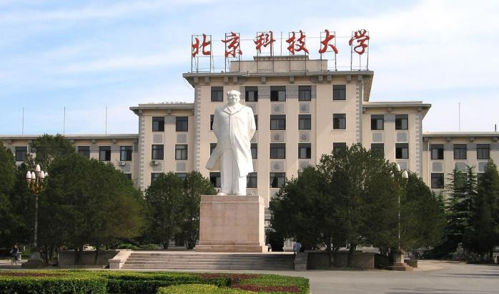

1
The simplest actor-critic (QAC)
2*
Advantage actor-critic (A2C)
3
Off-policy actor-critic
4
Deterministic actor-critic
5
Summary

Slide 3
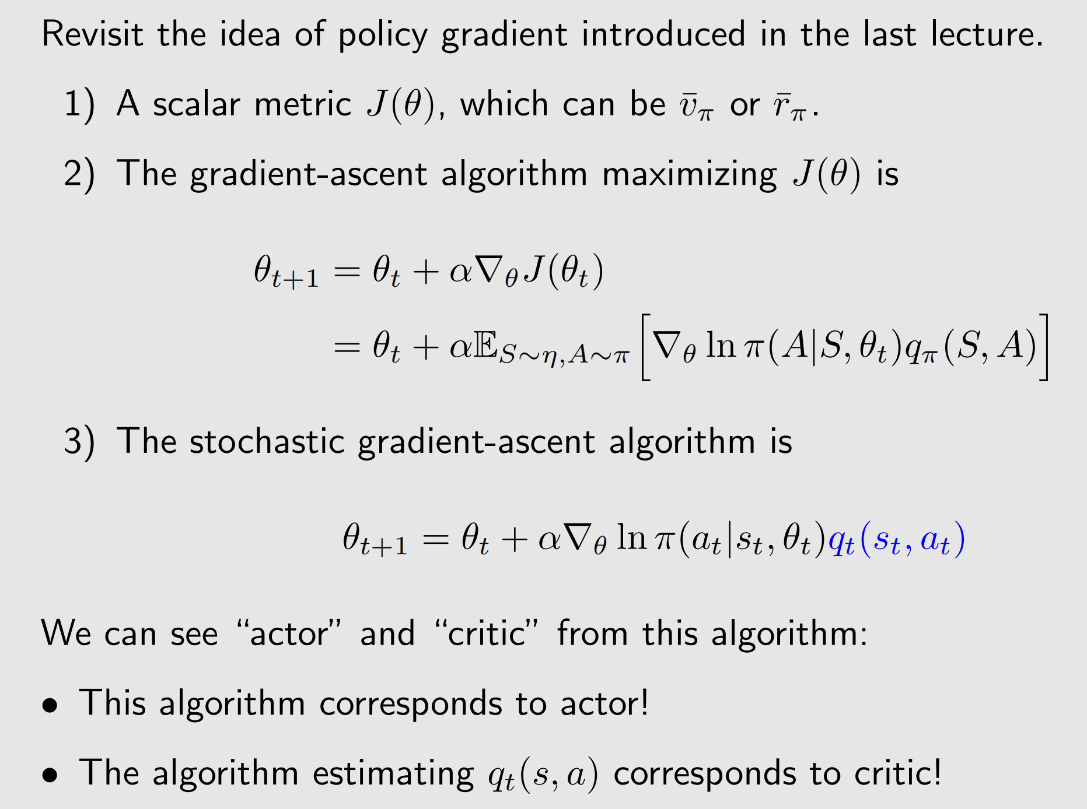
The simplest actor-critic

Slide 4
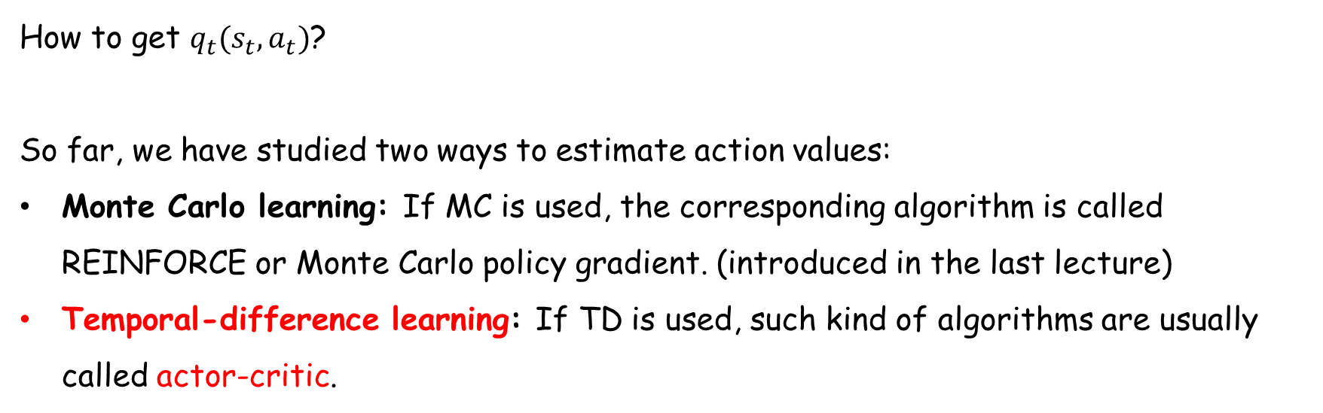
The simplest actor-critic
How to get $q_{t}(s_{t},a_{t})$?
So far, we have studied two ways to estimate action values:
Monte Carlo learning: If MC is used, the corresponding algorithm is called REINFORCE or Monte Carlo policy gradient. (introduced in the last lecture)
Temporal-difference learning: If TD is used, such kind of algorithms are usually called actor-critic.

Slide 5
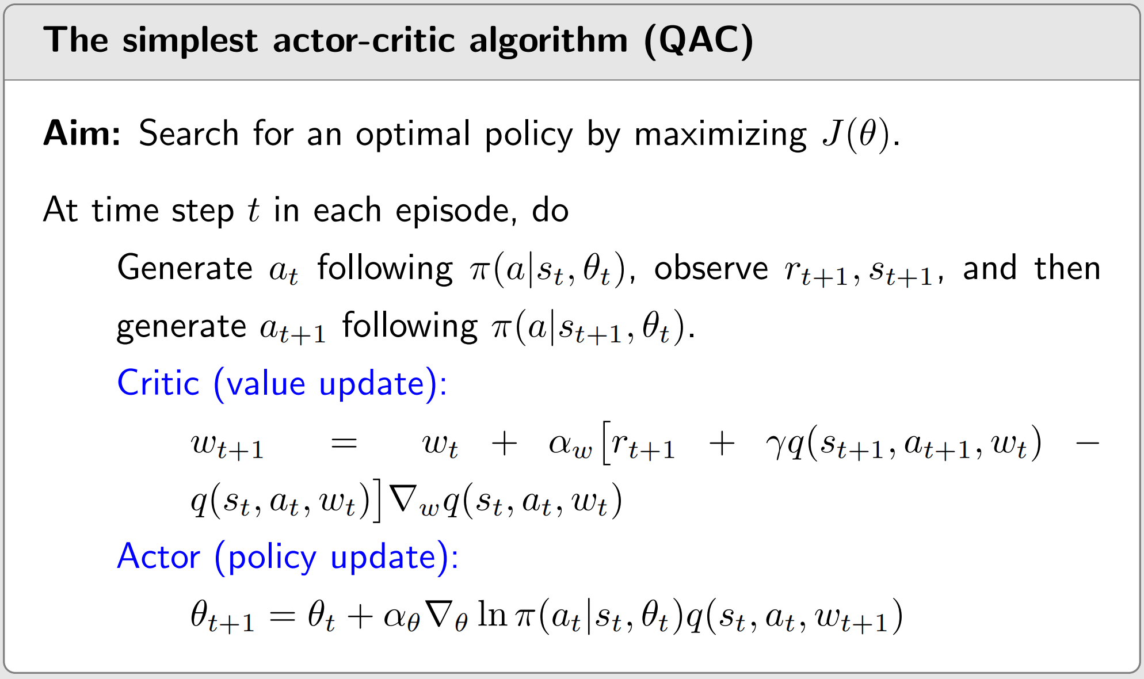
The simplest actor-critic

Slide 6
The simplest actor-critic
Remarks:
The critic corresponds to “SARSA+value function approximation”.
The actor corresponds to the policy update algorithm.
The algorithm is on-policy (why is PG on-policy?).
Since the policy is stochastic, no need to use techniques like ε-greedy.
This particular actor-citric algorithm is sometimes referred to as Q Actor-Critic (QAC).
Though simple, this algorithm reveals the core idea of actor-critic methods. It can be extended to generate many other algorithms as shown later.

Slide 7
1
The simplest actor-critic (QAC)
2*
Advantage actor-critic (A2C)
we extend QAC to advantage actor-critic (A2C)
• The core idea is to introduce a baseline to reduce variance.
Baseline invariance
The algorithm of advantage actor-critic
3
Off-policy actor-critic
4
Deterministic actor-critic
5
Summary

Slide 8
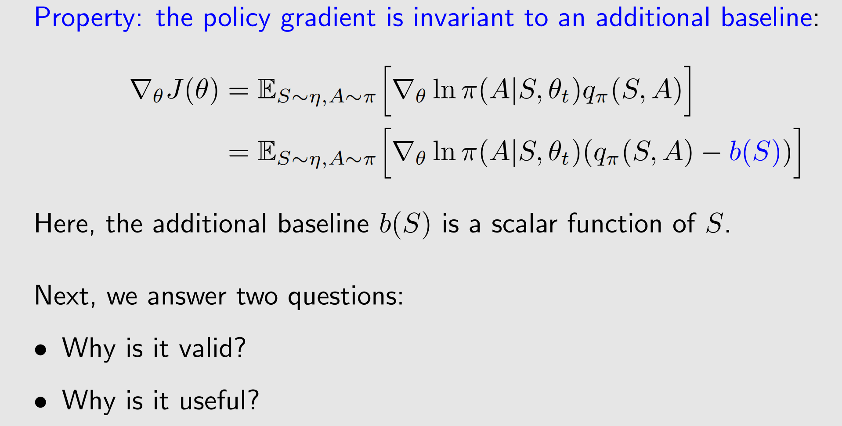
Baseline invariance

Slide 9
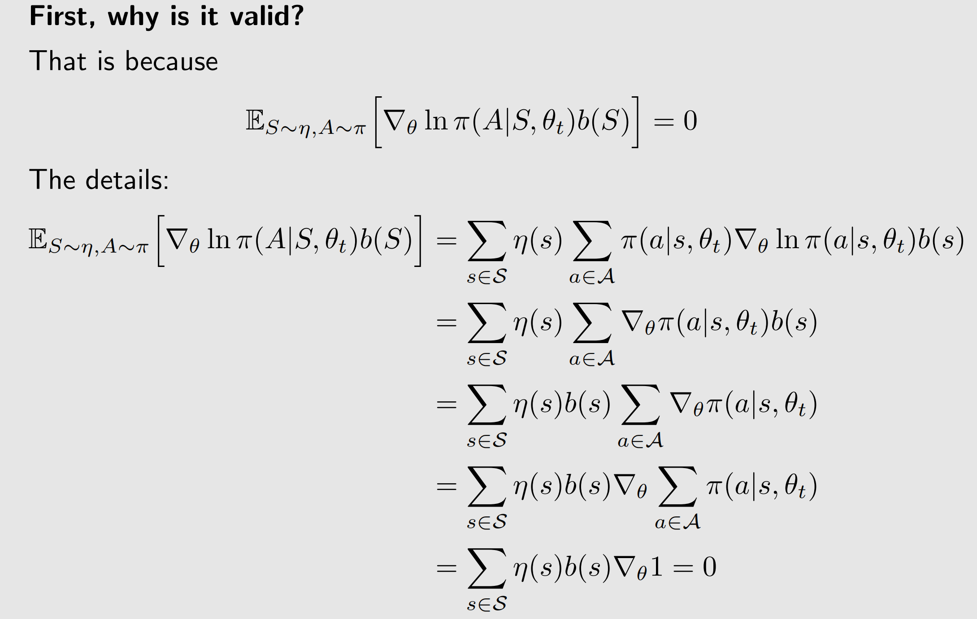
Baseline invariance

Slide 10
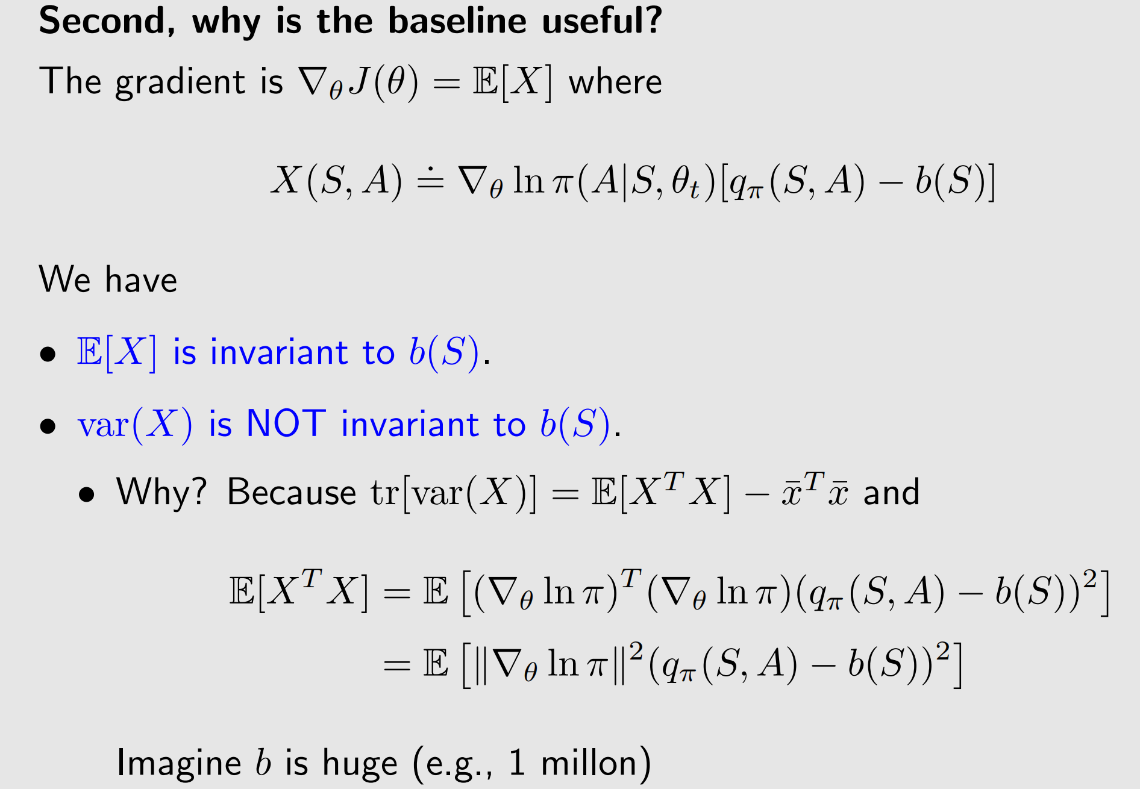
Baseline invariance

Slide 11
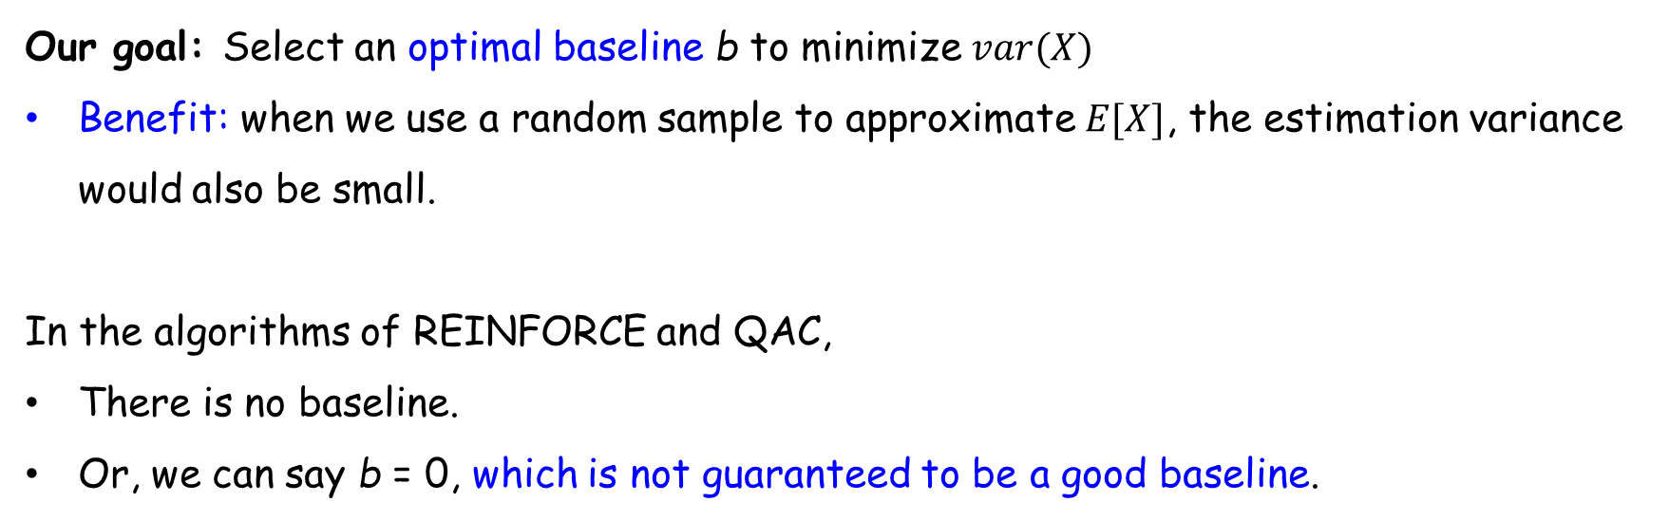
Baseline invariance
Our goal: Select an optimal baseline b to minimize $var(X)$
Benefit: when we use a random sample to approximate $E[X]$, the estimation variance would also be small.
In the algorithms of REINFORCE and QAC,
There is no baseline.
Or, we can say b = 0, which is not guaranteed to be a good baseline.

Slide 12
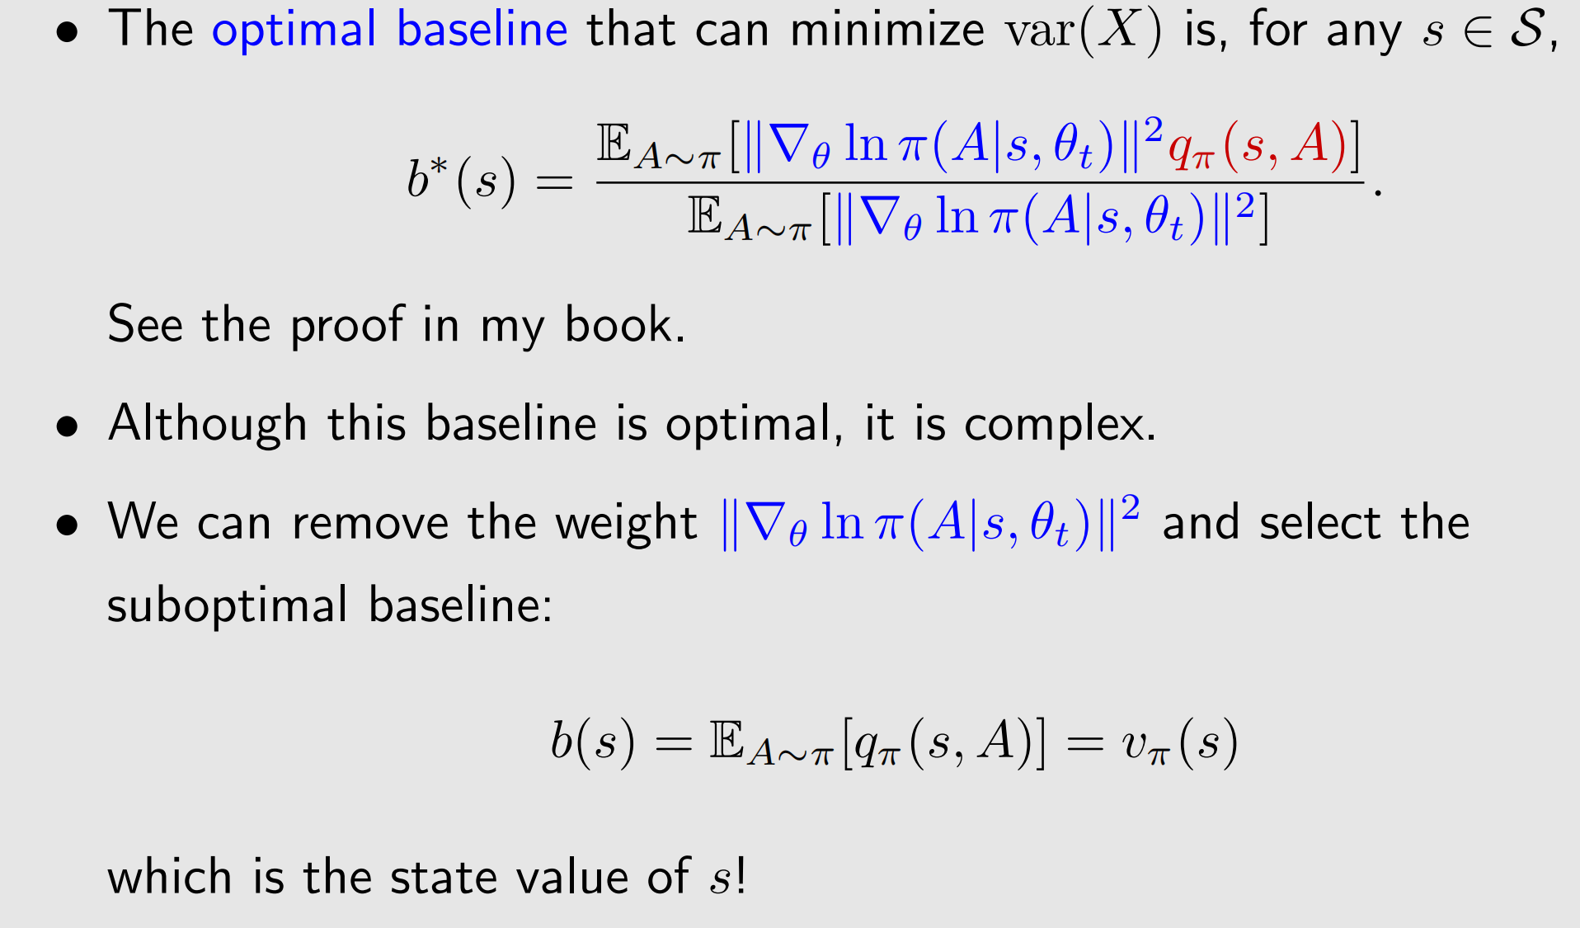
Baseline invariance

Slide 13
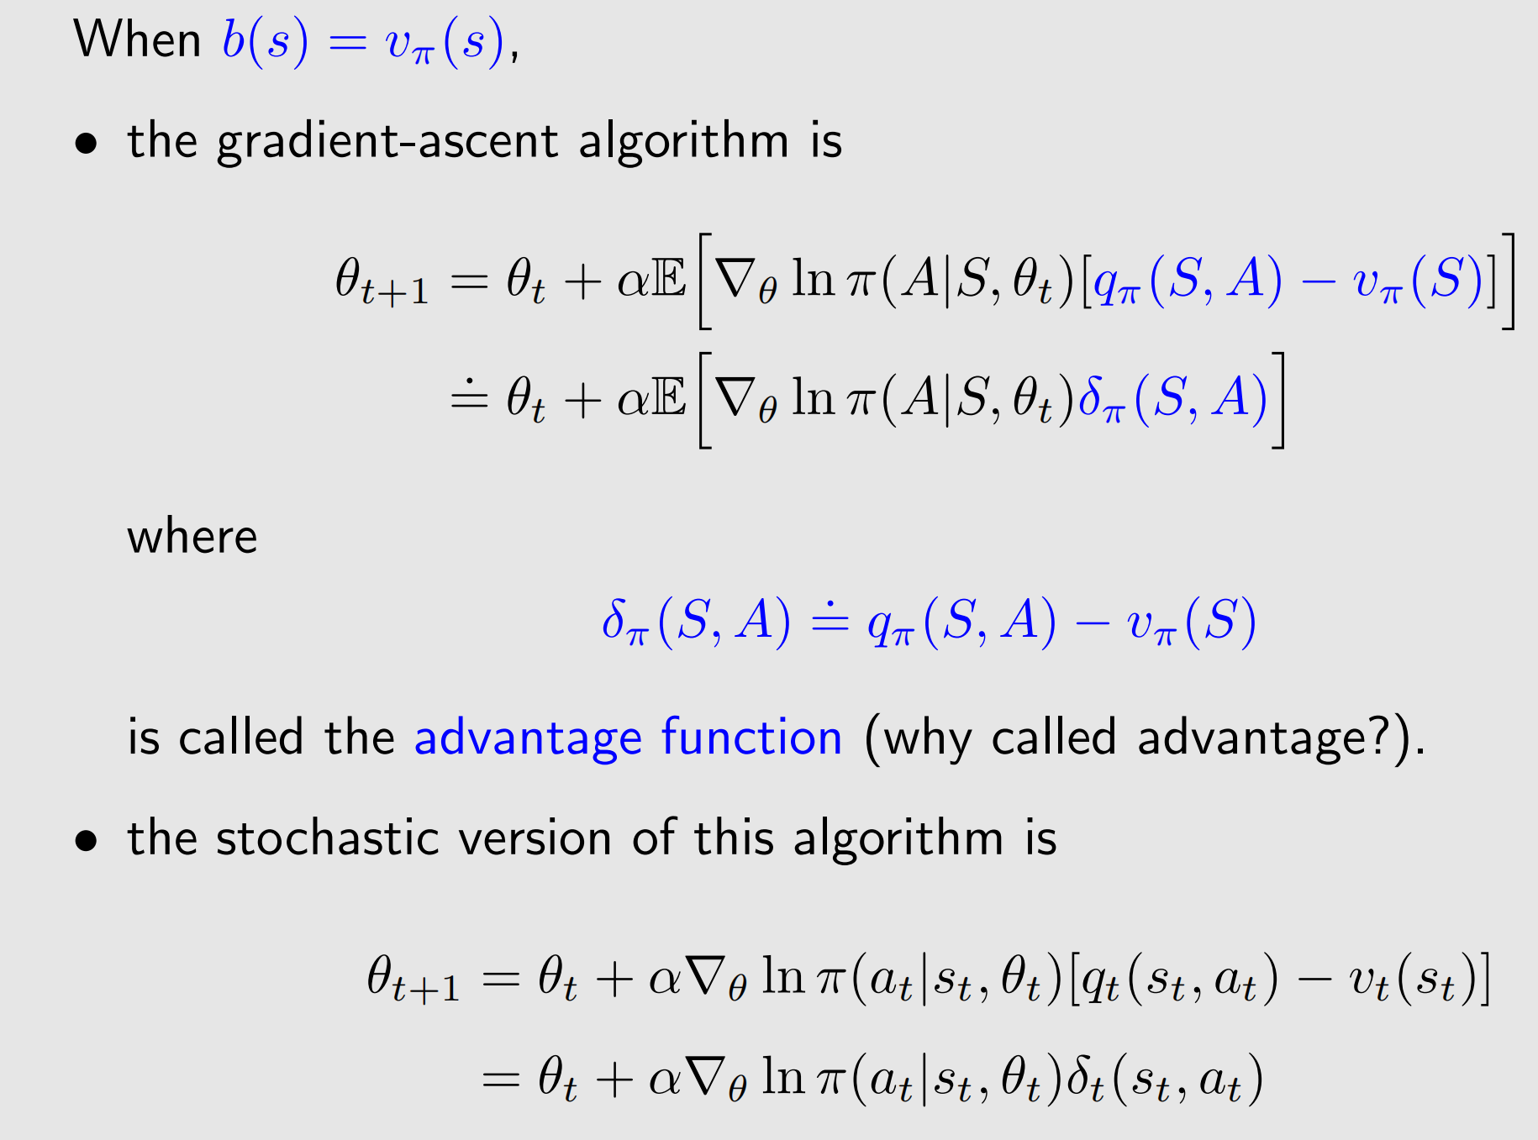
The algorithm of advantage actor-critic

Slide 14
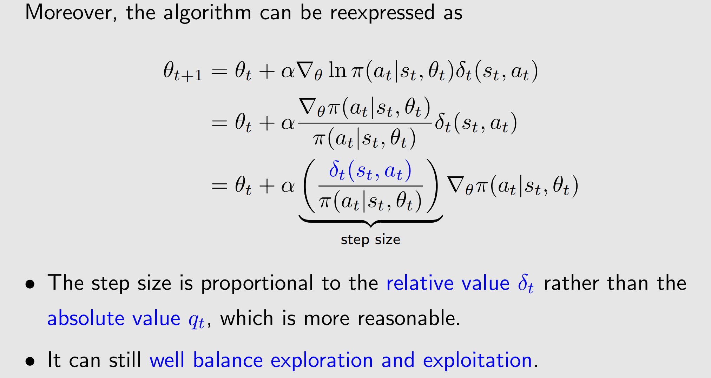
The algorithm of advantage actor-critic

Slide 15
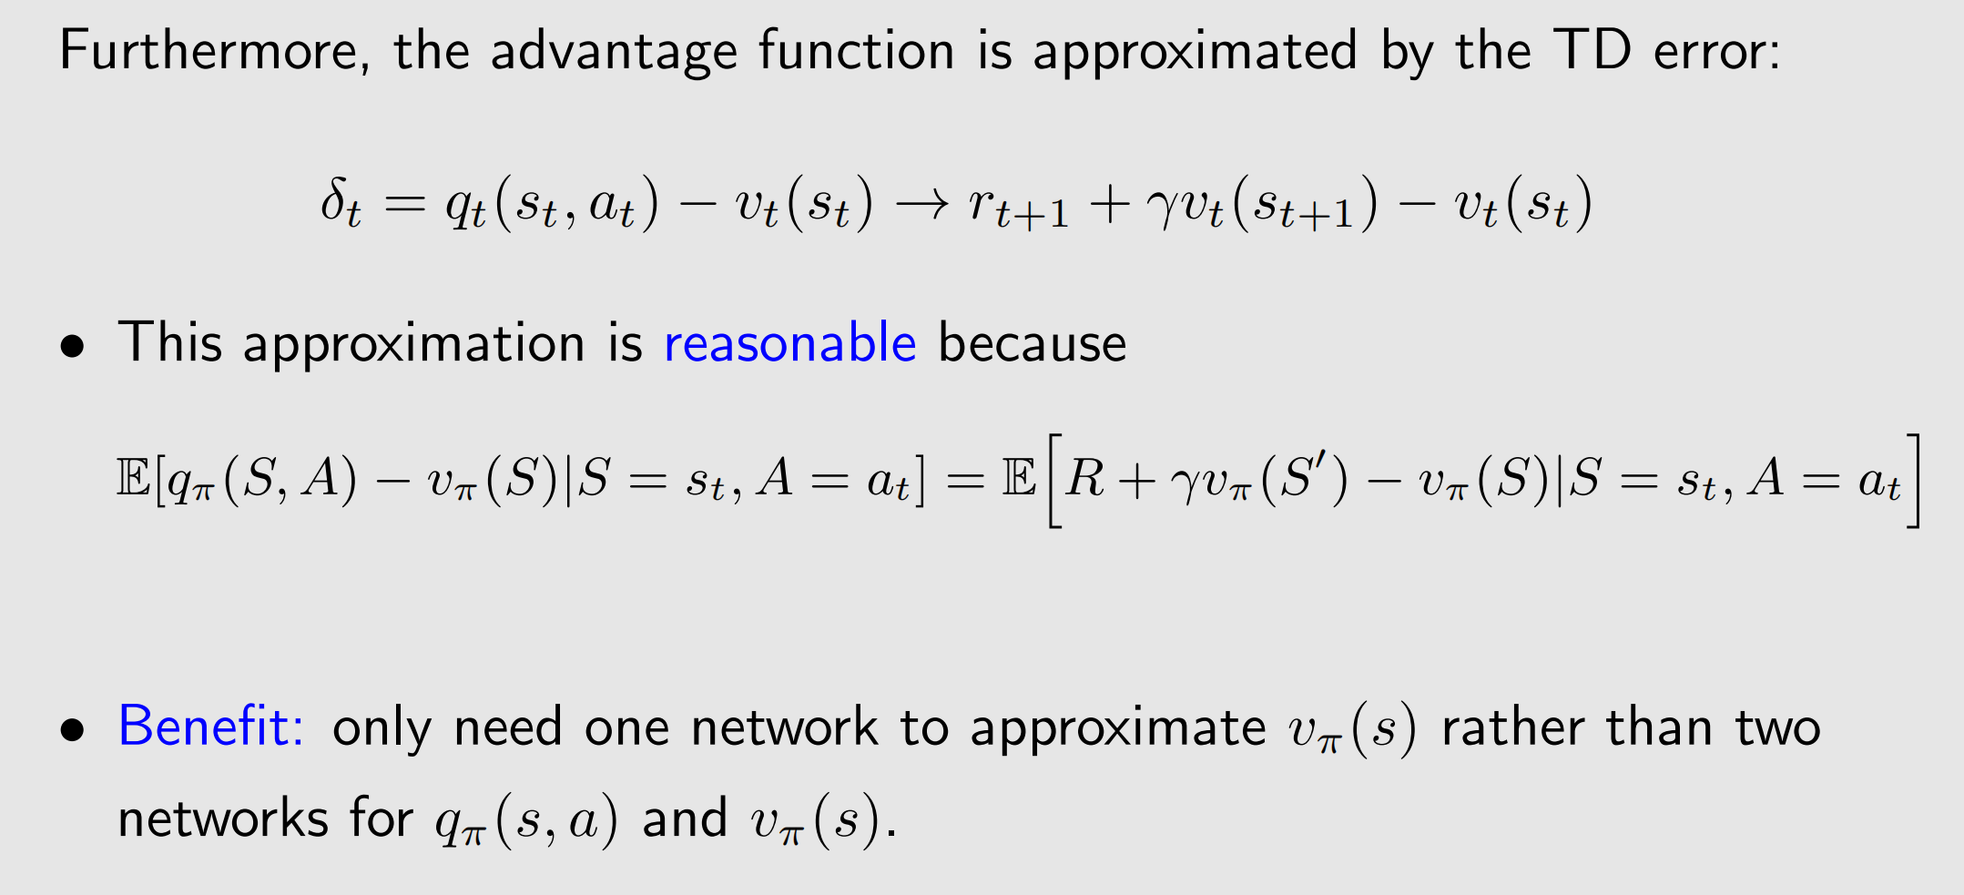
The algorithm of advantage actor-critic

Slide 16
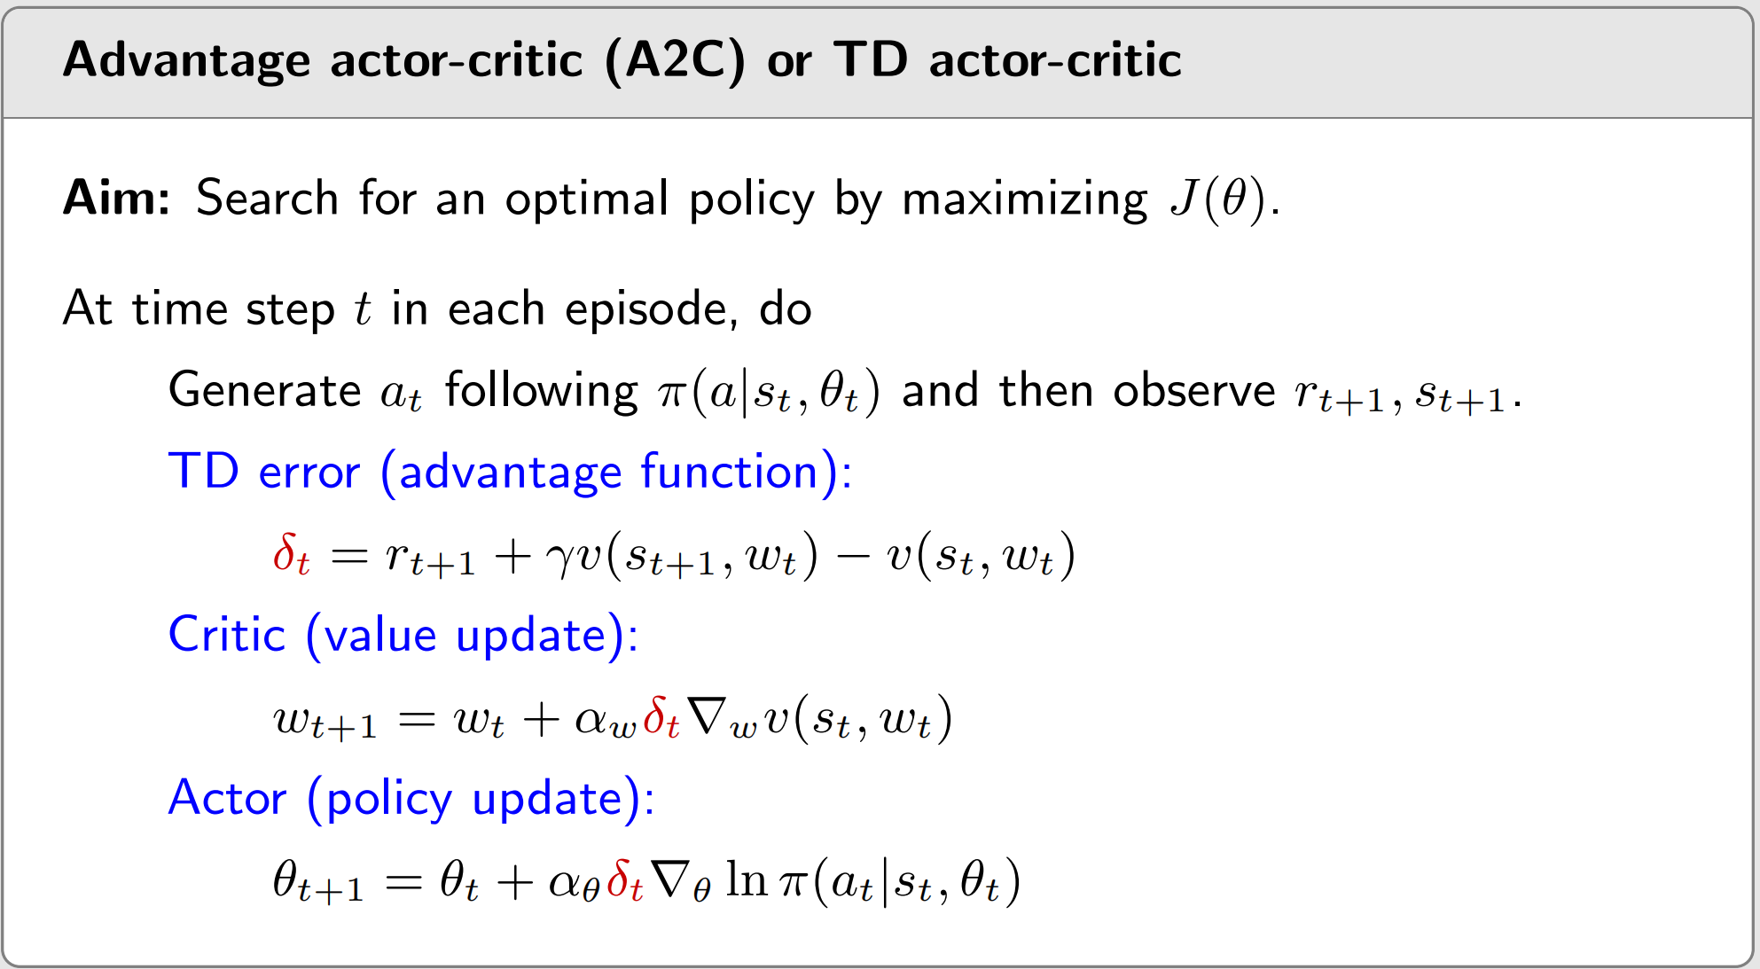
The algorithm of advantage actor-critic
It is on-policy. Since the policy $π(θ_{t})$is stochastic, no need to use techniques like ε-greedy.

Slide 17
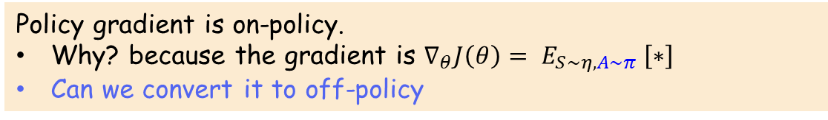
1
The simplest actor-critic (QAC)
2*
Advantage actor-critic (A2C)
3
Off-policy actor-critic
Policy gradient is on-policy.
Why? because the gradient is $∇_{θ}J\left(θ\right)= E_{S∼η,A∼π} \left[∗\right]$
Can we convert it to off-policy
Illustrative examples
Importance sampling
The theorem of off-policy policy gradient
The algorithm of off-policy actor-critic
4
Deterministic actor-critic
5
Summary

Slide 18
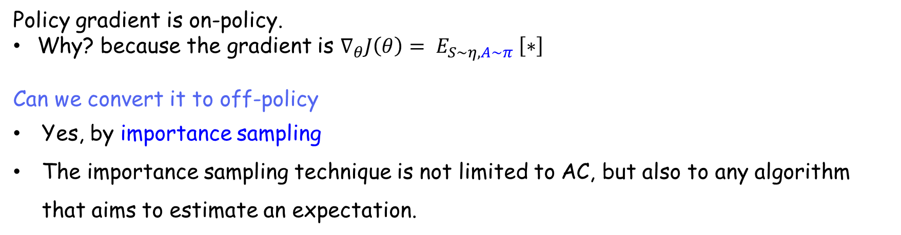
Introduction
Policy gradient is on-policy.
Why? because the gradient is $∇_{θ}J\left(θ\right)= E_{S∼η,A∼π} \left[∗\right]$
Can we convert it to off-policy
Yes, by importance sampling
The importance sampling technique is not limited to AC, but also to any algorithm that aims to estimate an expectation.

Slide 19
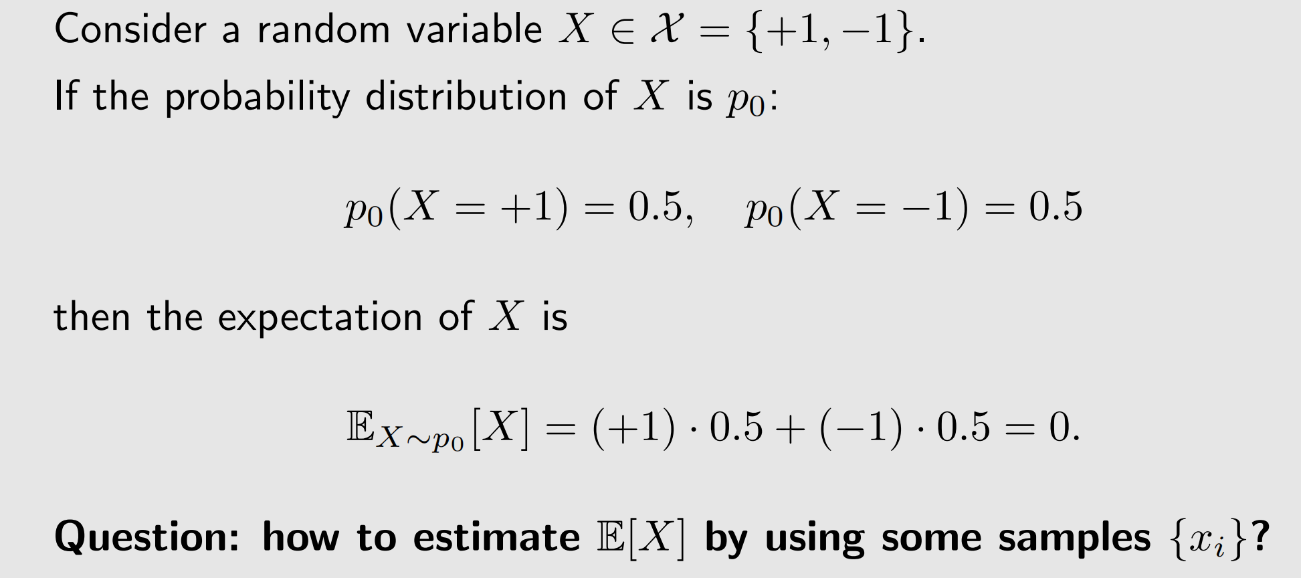
Illustrative examples

Slide 20
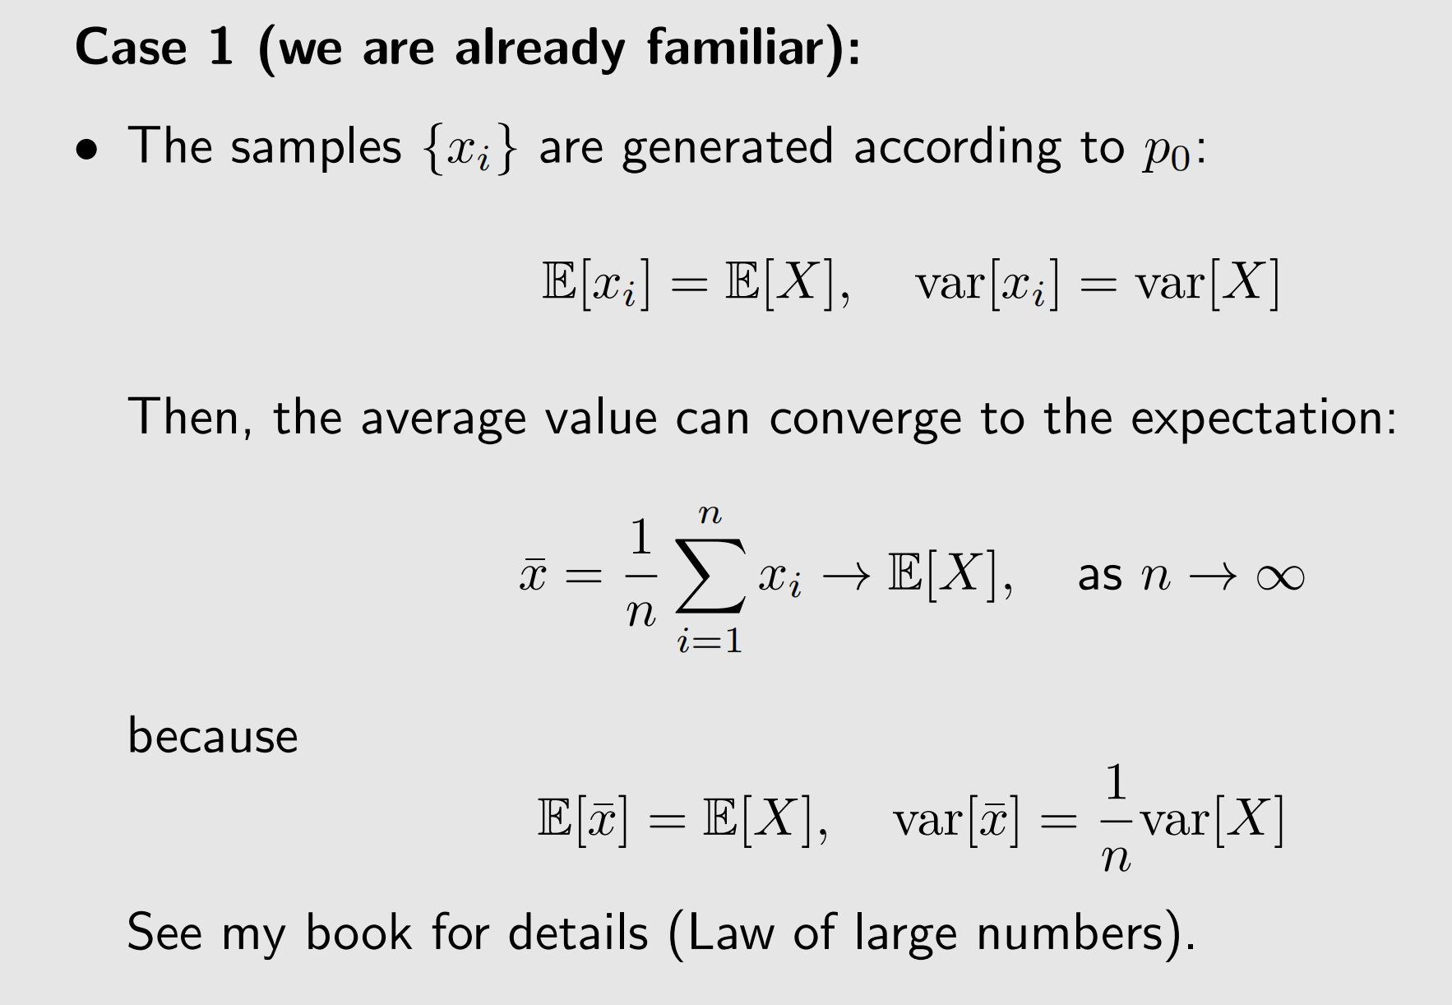
Illustrative examples

Slide 21
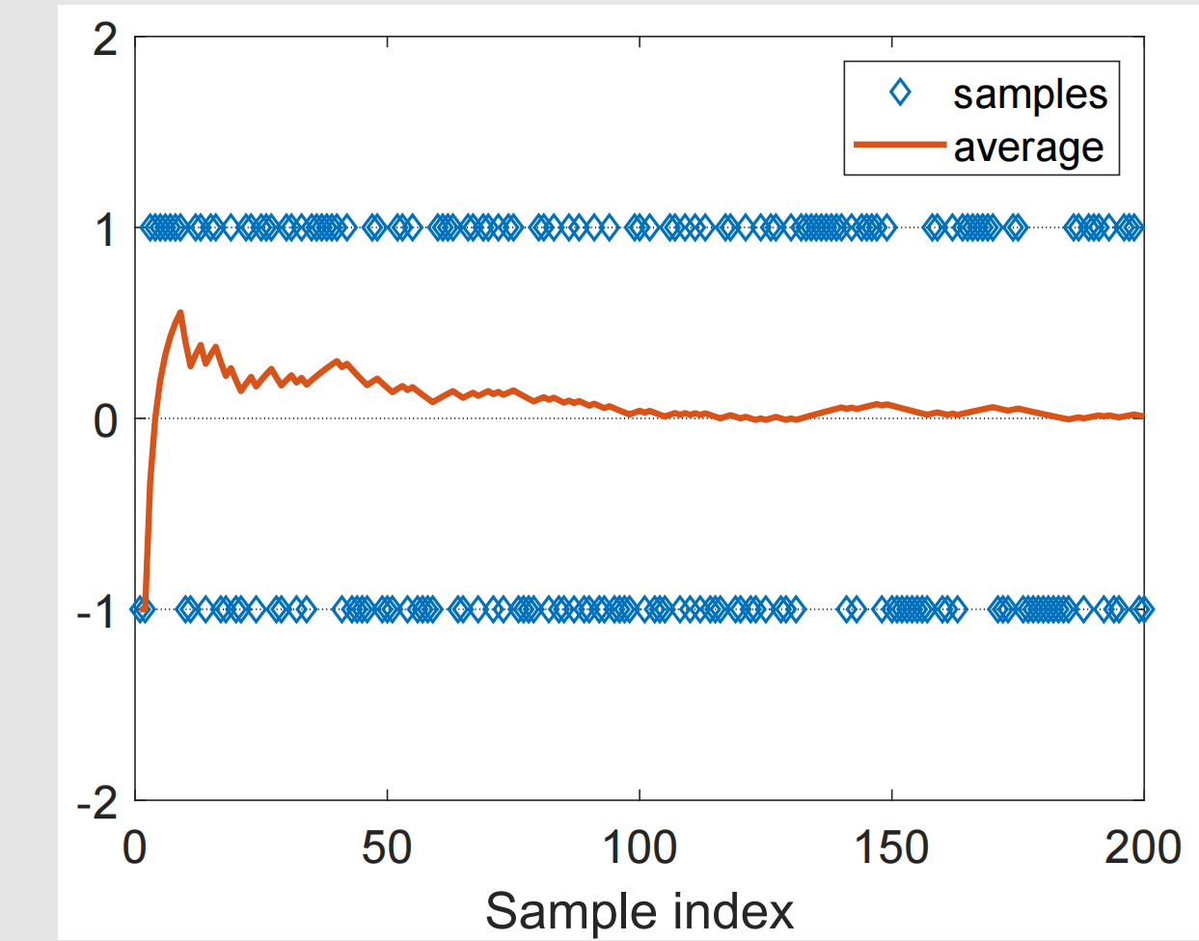
Illustrative examples
Figure: Samples and $\overline{x}→E[X]$

Slide 22
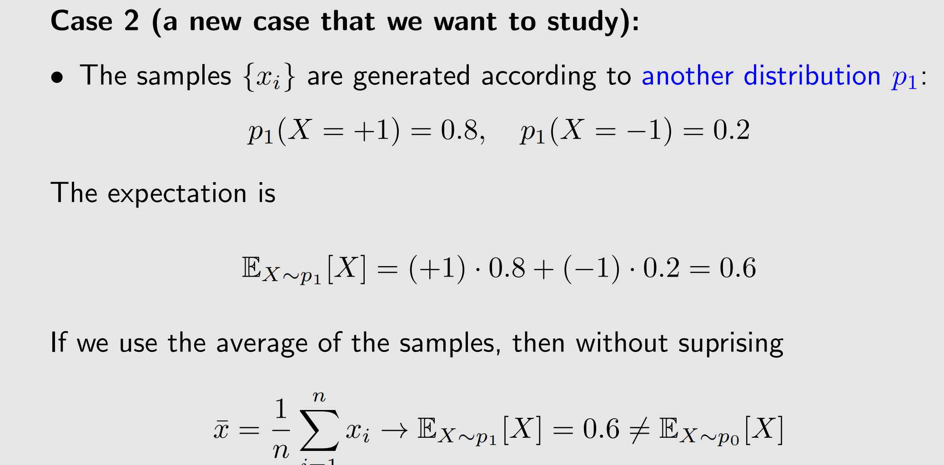
Illustrative examples

Slide 23
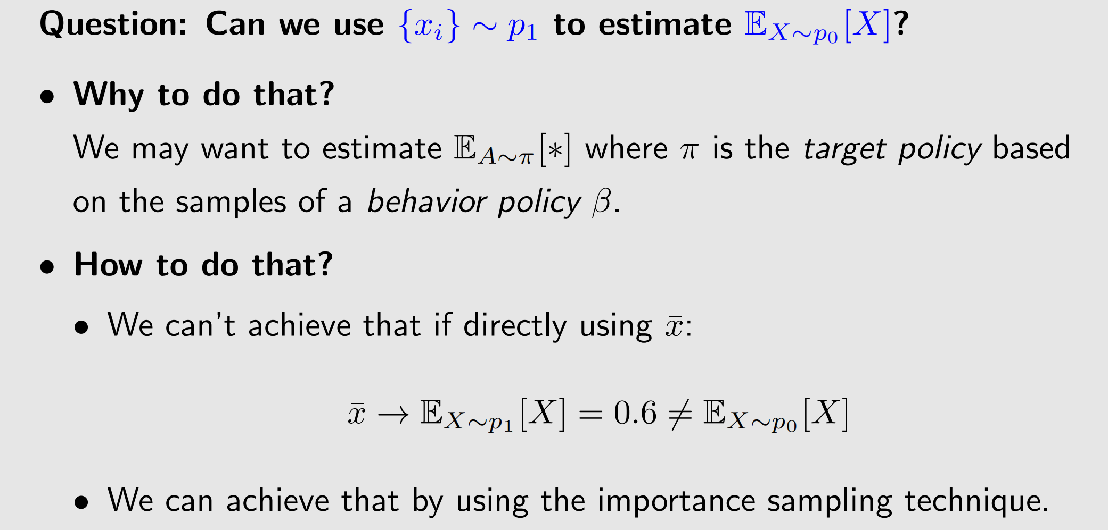
Illustrative examples

Slide 24
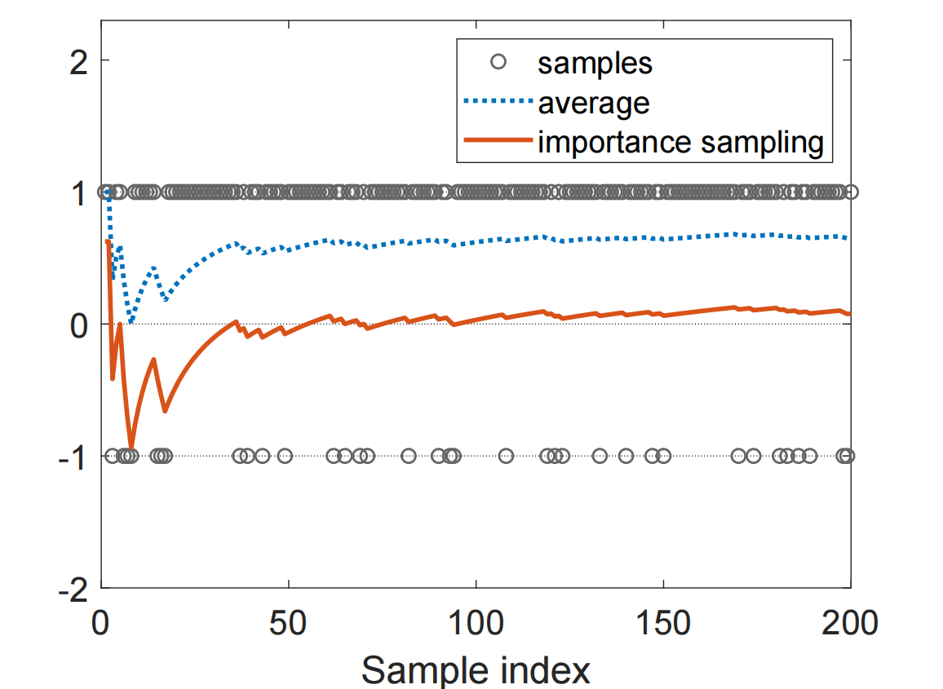
Illustrative examples
Figure: Samples and $\overline{x}→E_{X\sim p1} [X]$（the dotted line）

Slide 25
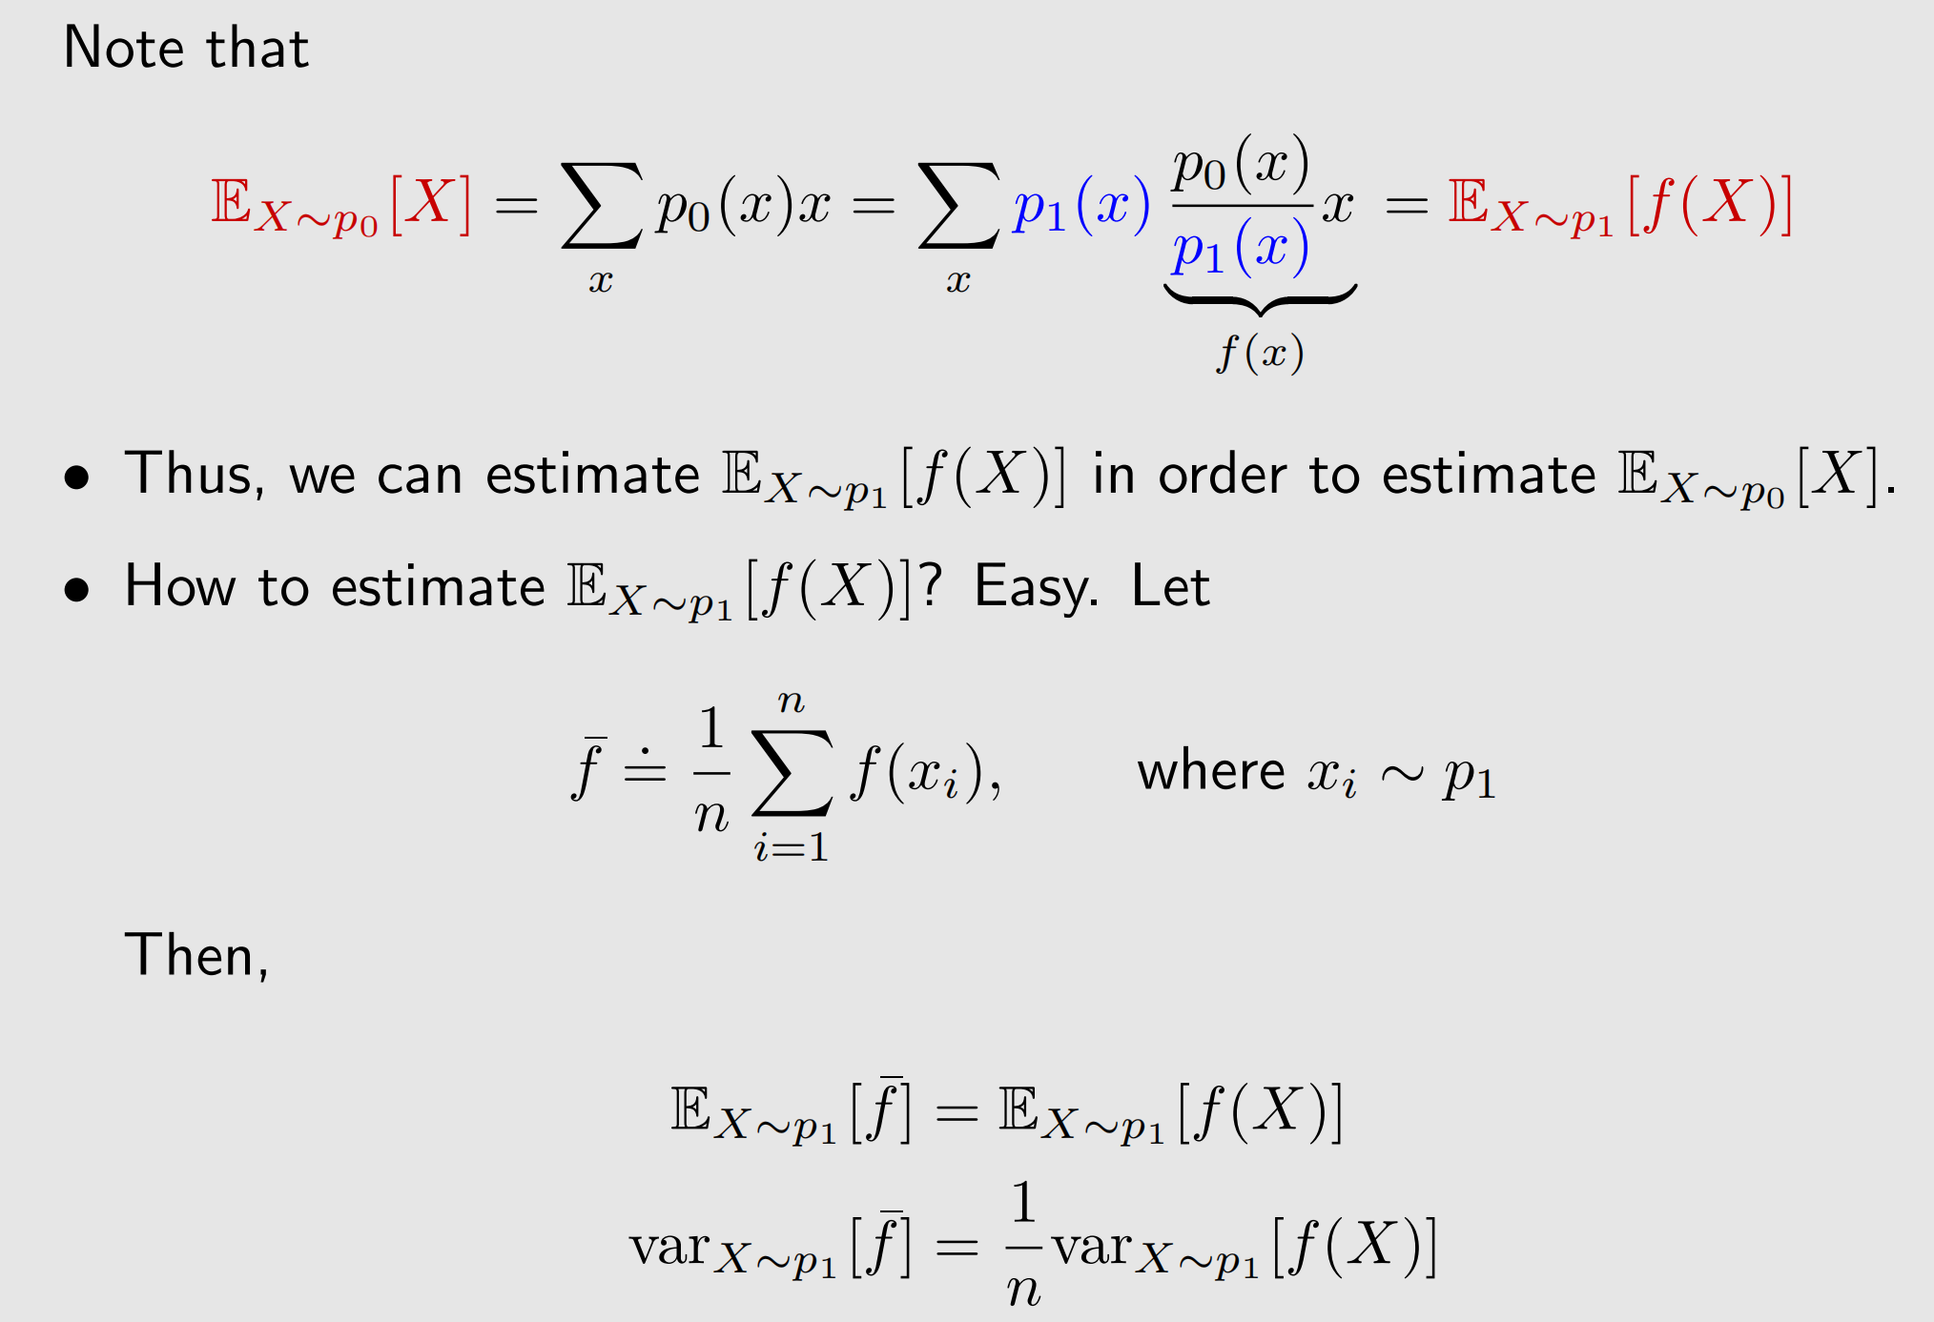
Importance sampling

Slide 26
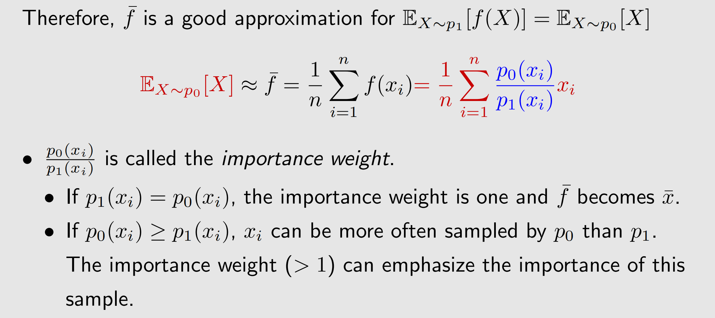
Importance sampling

Slide 27
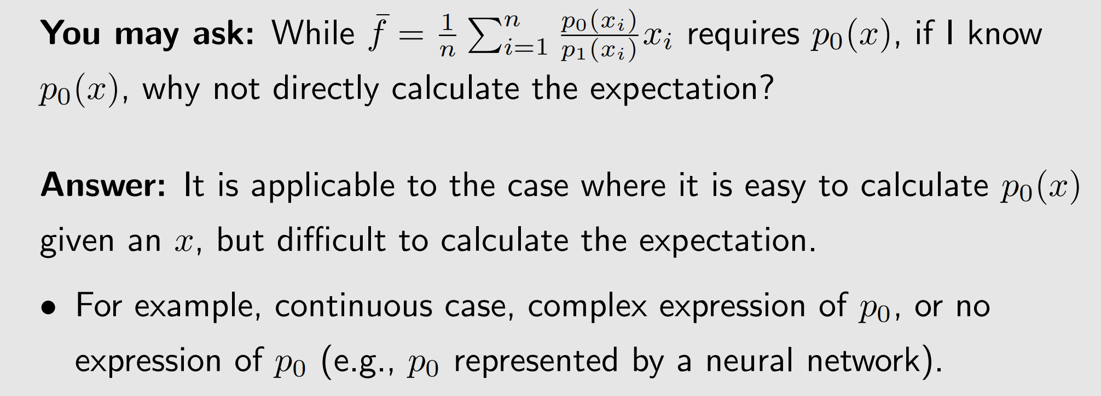
Importance sampling

Slide 28
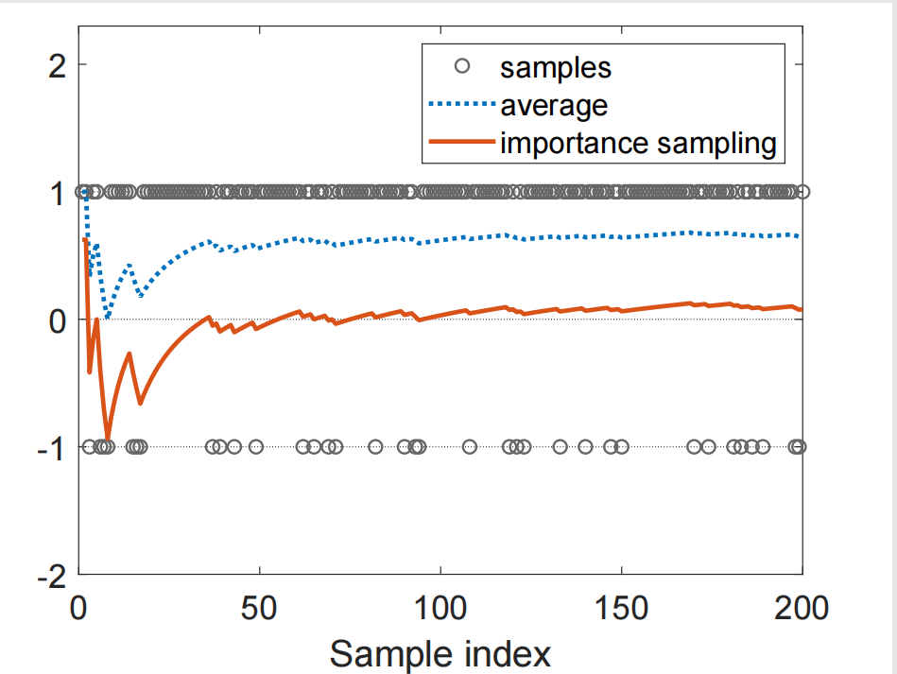
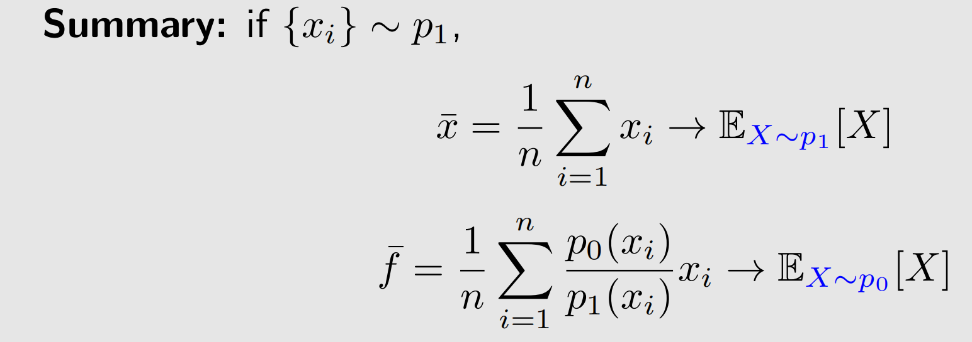
Importance sampling
Figure: Blue dotted line: $\overline{x}$ ; Red dotted line: $\overline{f}$

Slide 29
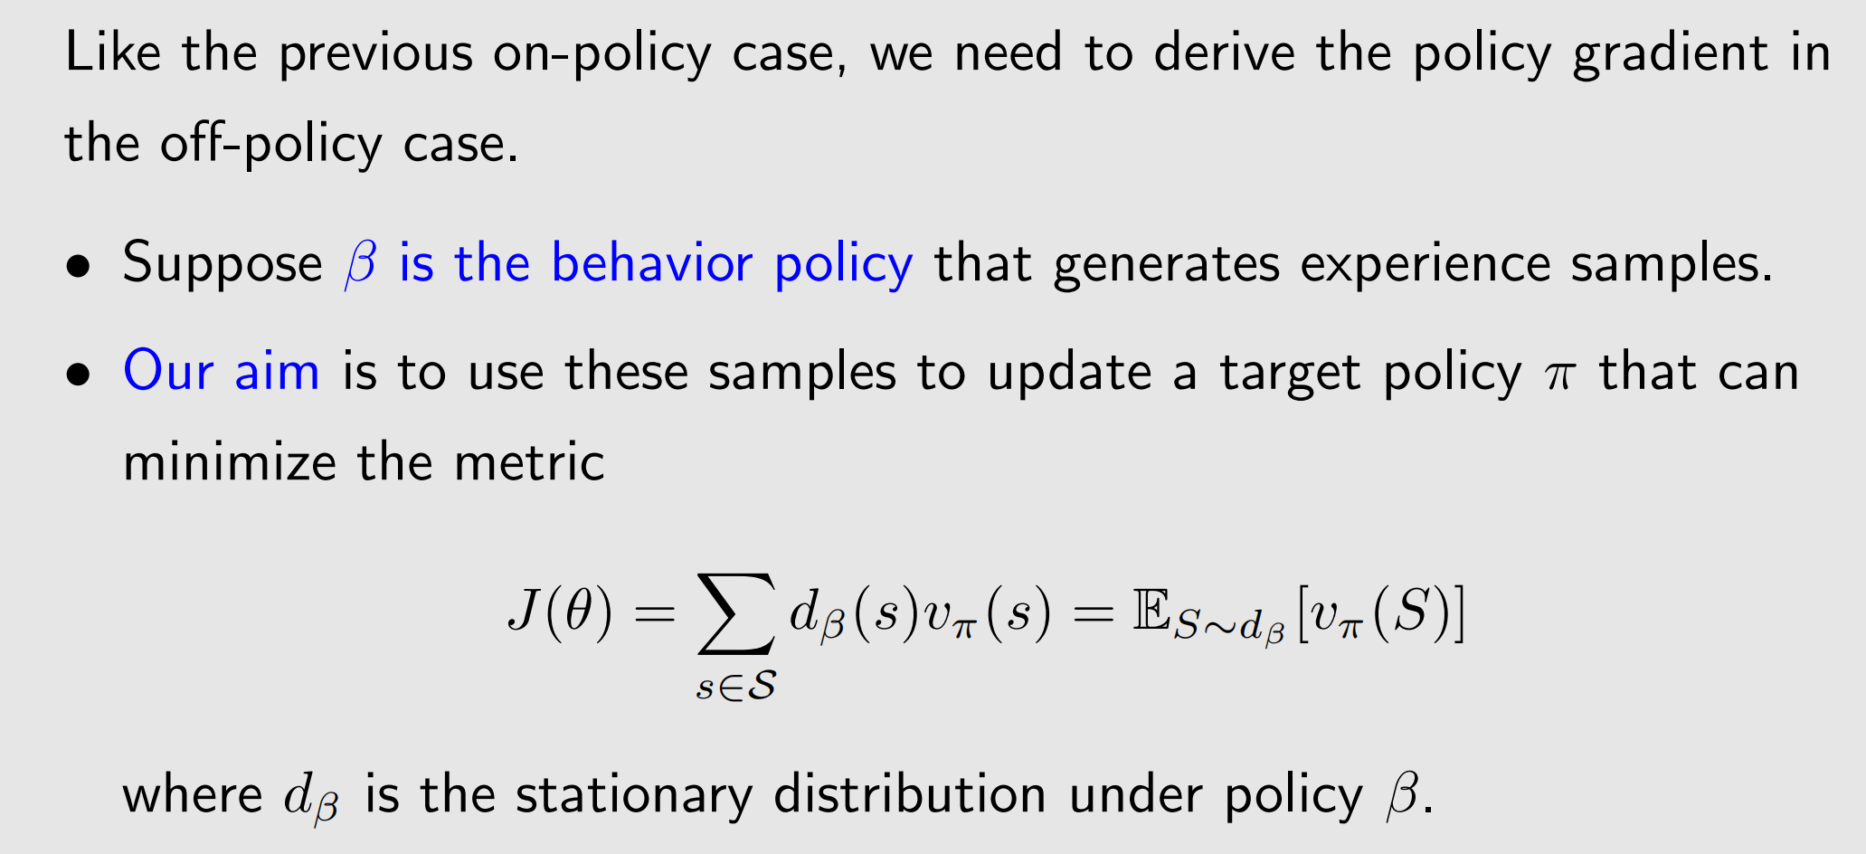
The theorem of off-policy policy gradient

Slide 30
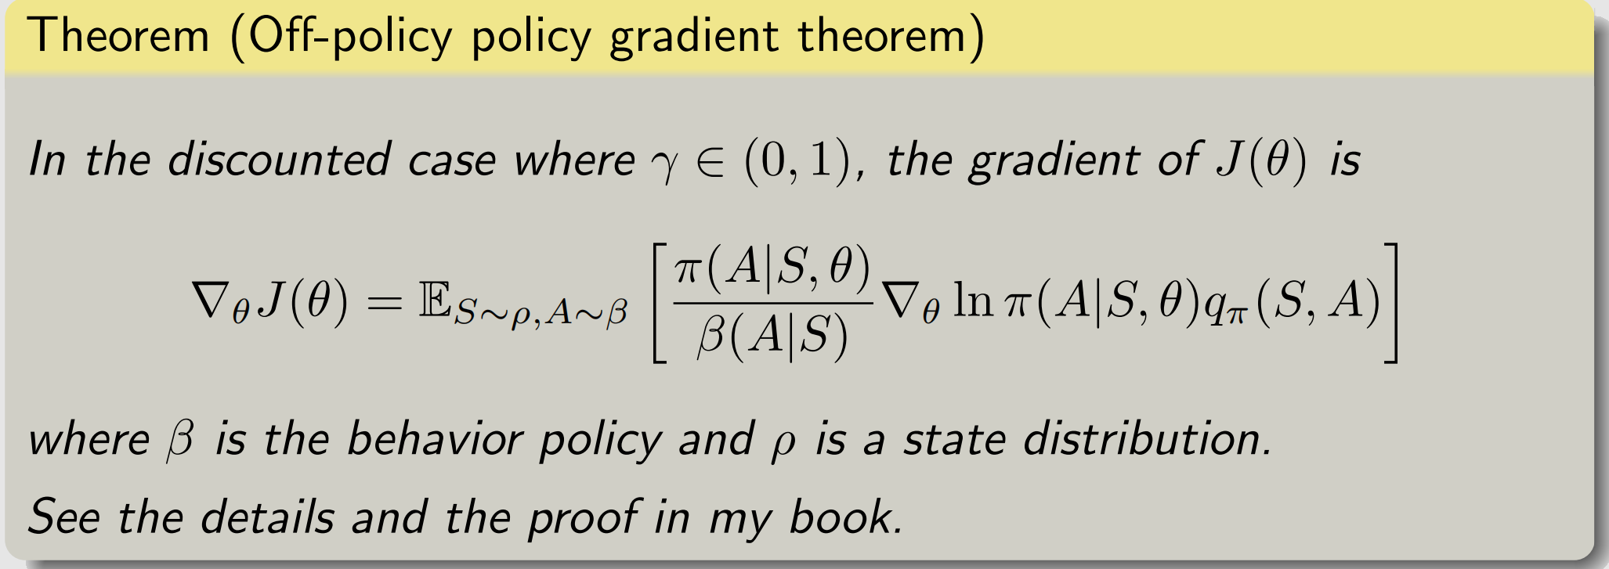
The theorem of off-policy policy gradient

Slide 31
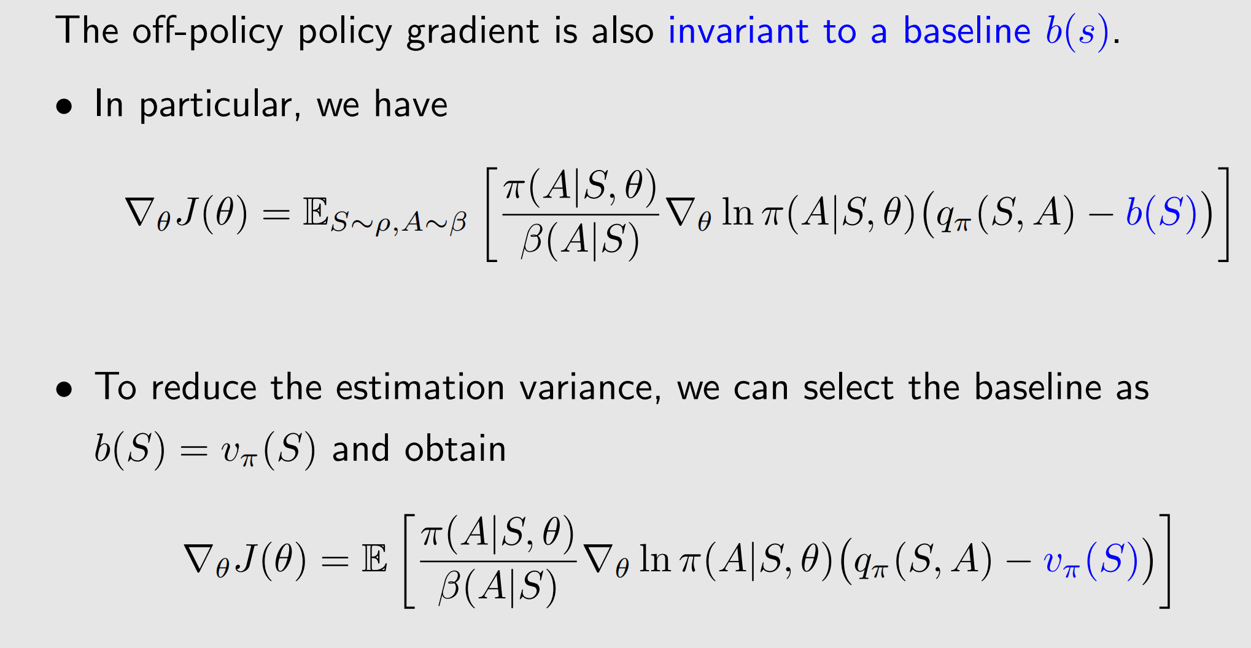
The algorithm of off-policy actor-critic

Slide 32
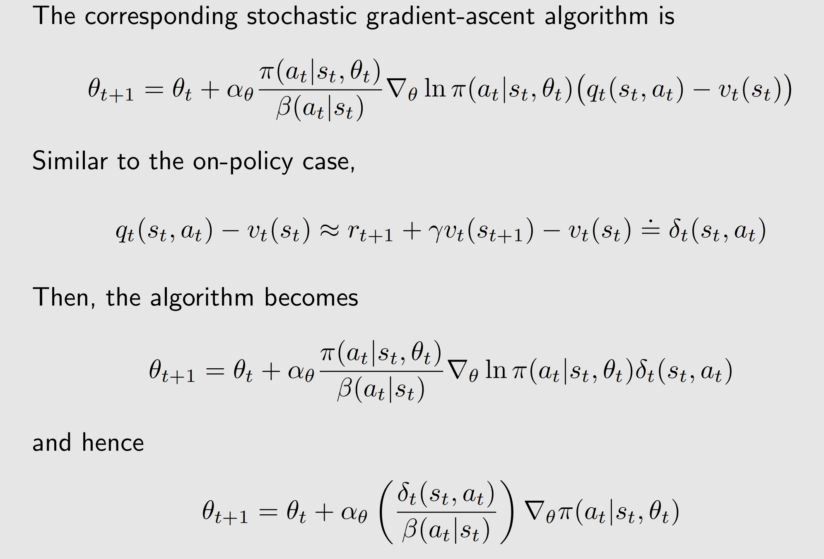
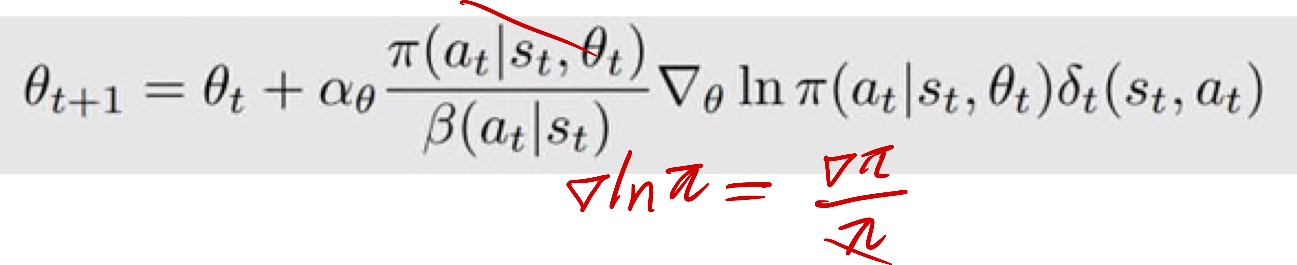
The algorithm of off-policy actor-critic
不可变策略

Slide 33
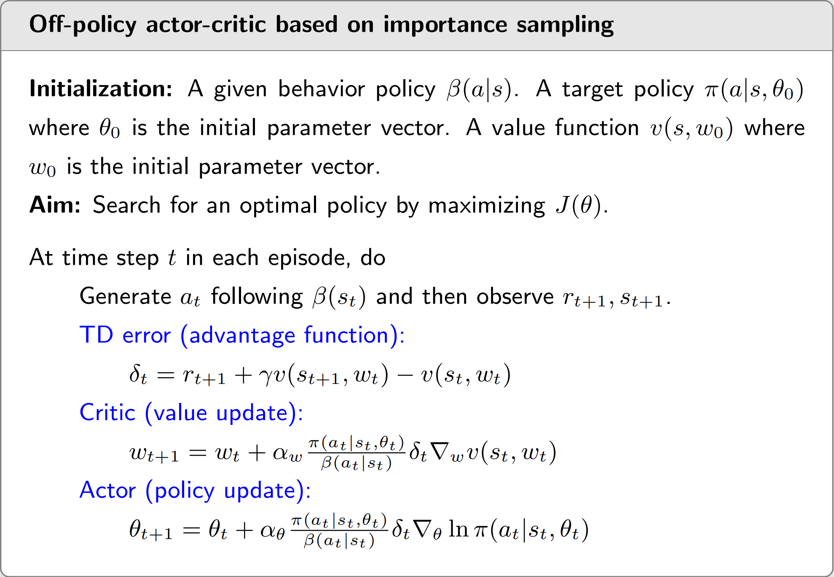
The algorithm of off-policy actor-critic

Slide 34
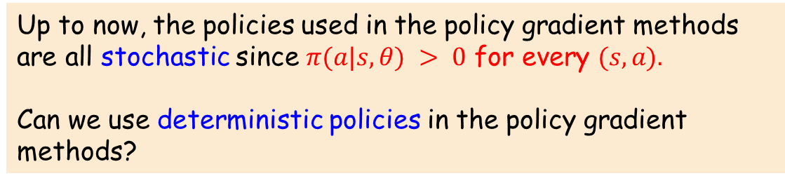
1
The simplest actor-critic (QAC)
2*
Advantage actor-critic (A2C)
3
Off-policy actor-critic
4
Deterministic actor-critic
Up to now, the policies used in the policy gradient methods are all stochastic since $π(a|s, θ) > 0$ for every $(s, a).$
Can we use deterministic policies in the policy gradient methods?
The theorem of deterministic policy gradient
The algorithm of deterministic actor-critic
5
Summary

Slide 35
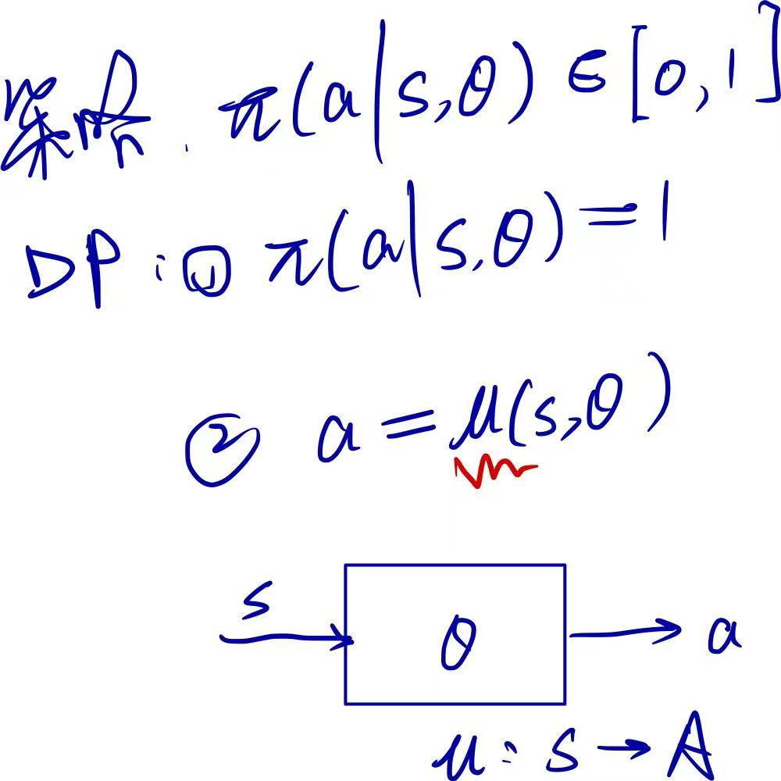
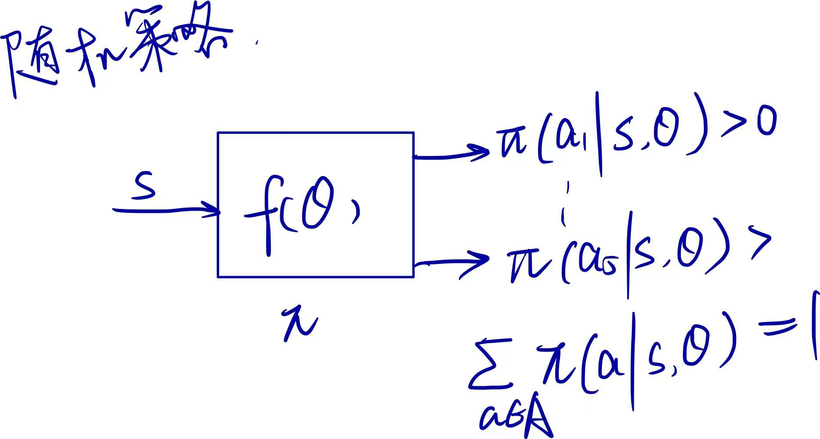
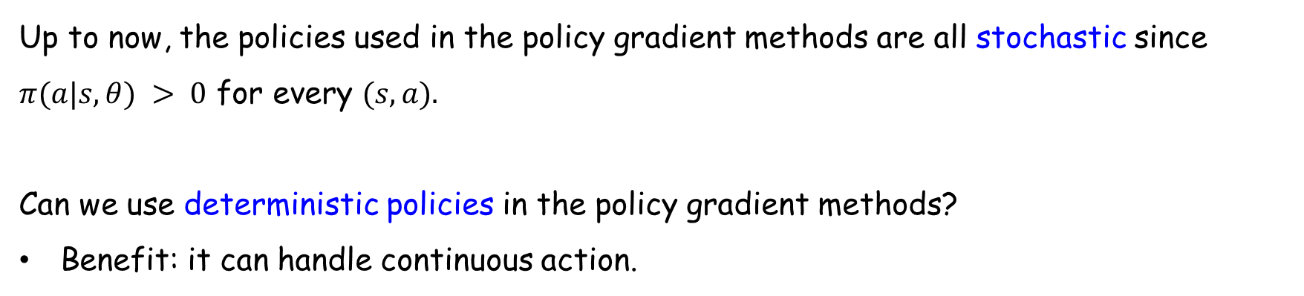
Introduction
Up to now, the policies used in the policy gradient methods are all stochastic since $π(a|s, θ) > 0$ for every $(s, a).$
Can we use deterministic policies in the policy gradient methods?
Benefit: it can handle continuous action.

Slide 36
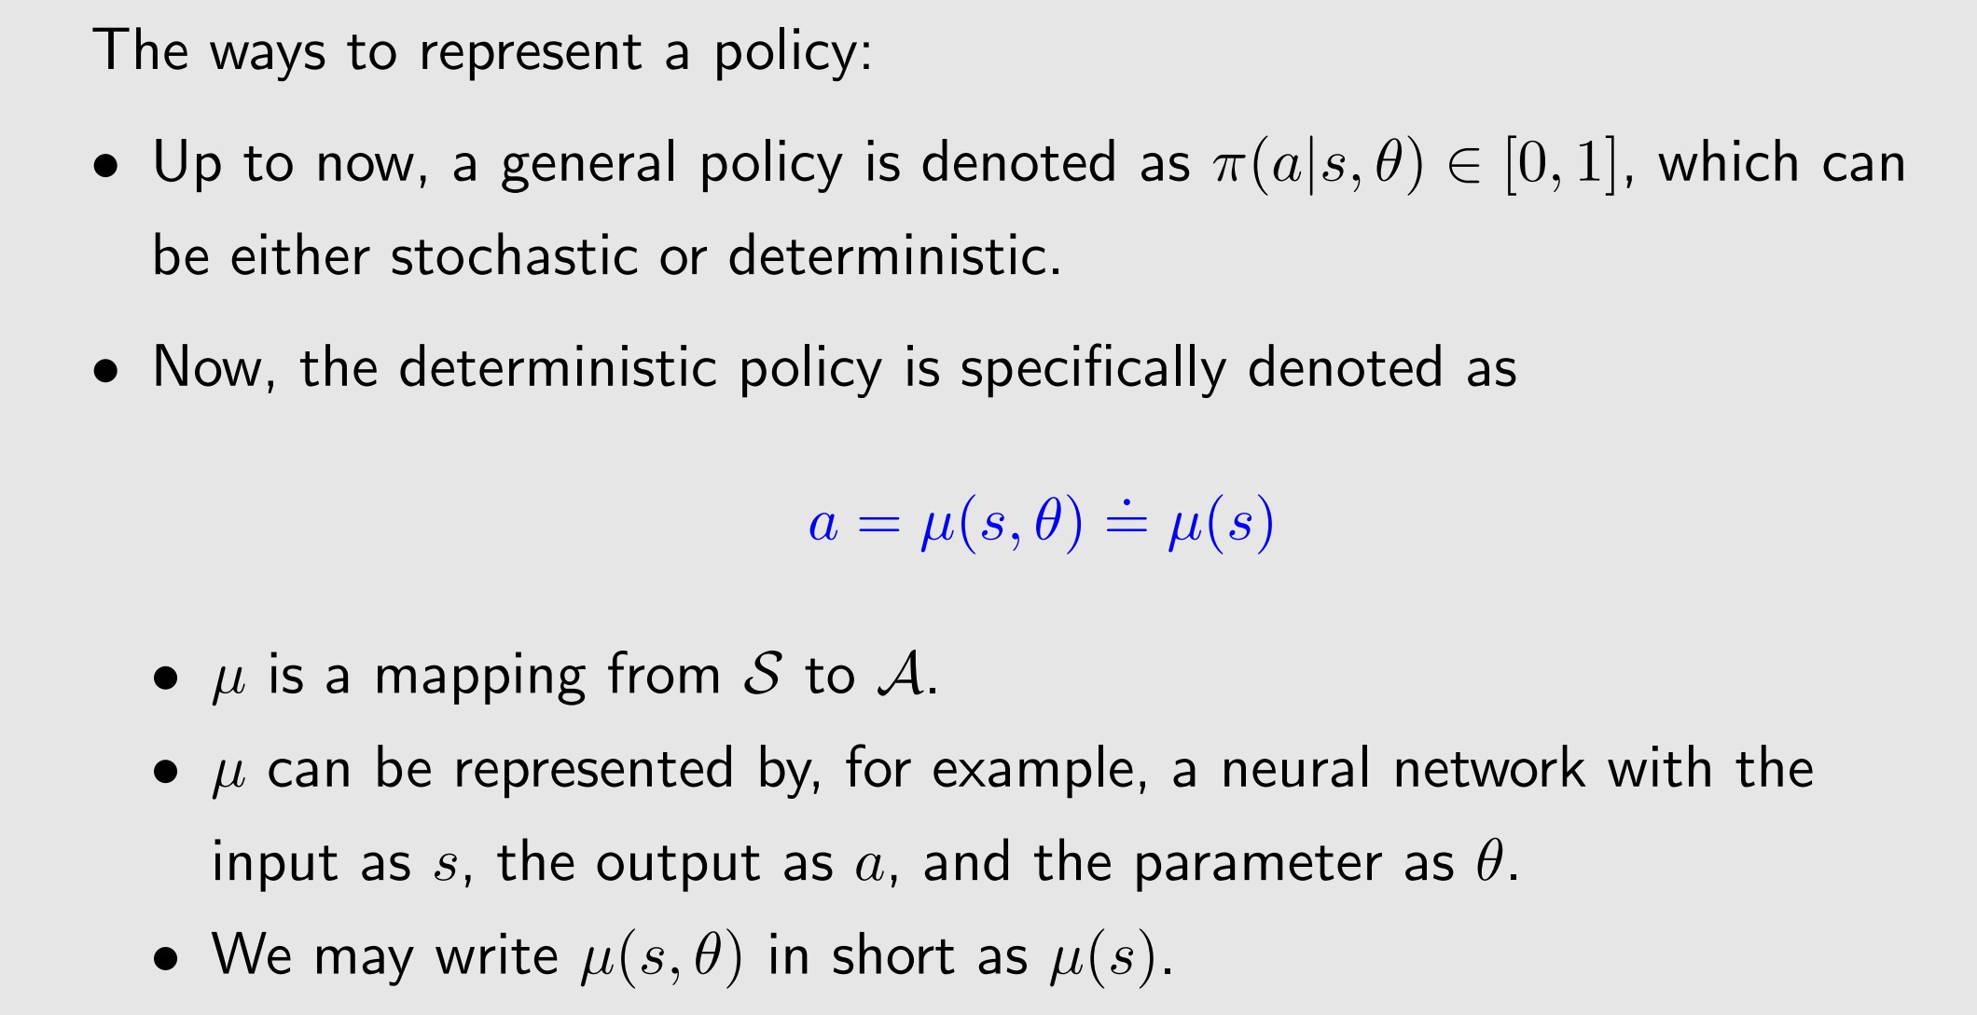
Introduction

Slide 37
The theorem of deterministic policy gradient
The policy gradient theorems introduced before are merely valid for stochastic policies.
If the policy must be deterministic, we must derive a new policy gradient theorem.
The ideas and procedures are similar.

Slide 38
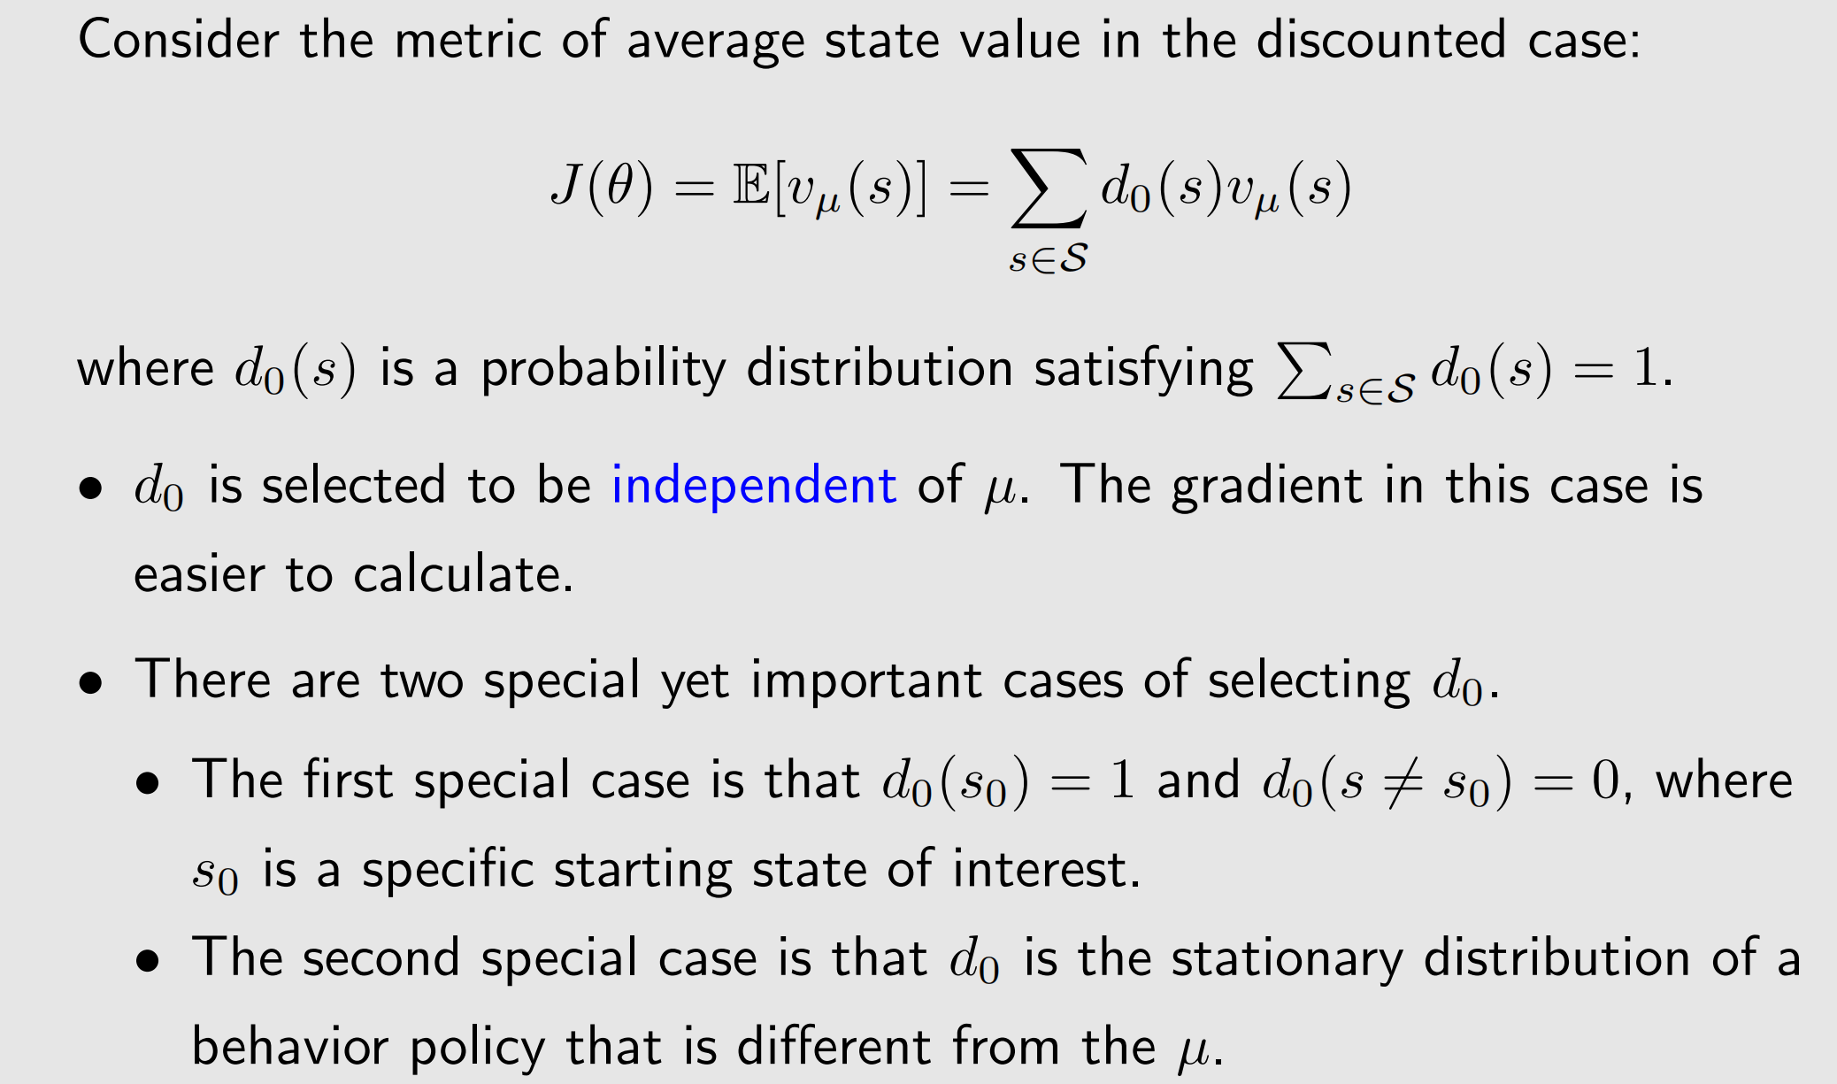
The theorem of deterministic policy gradient

Slide 39
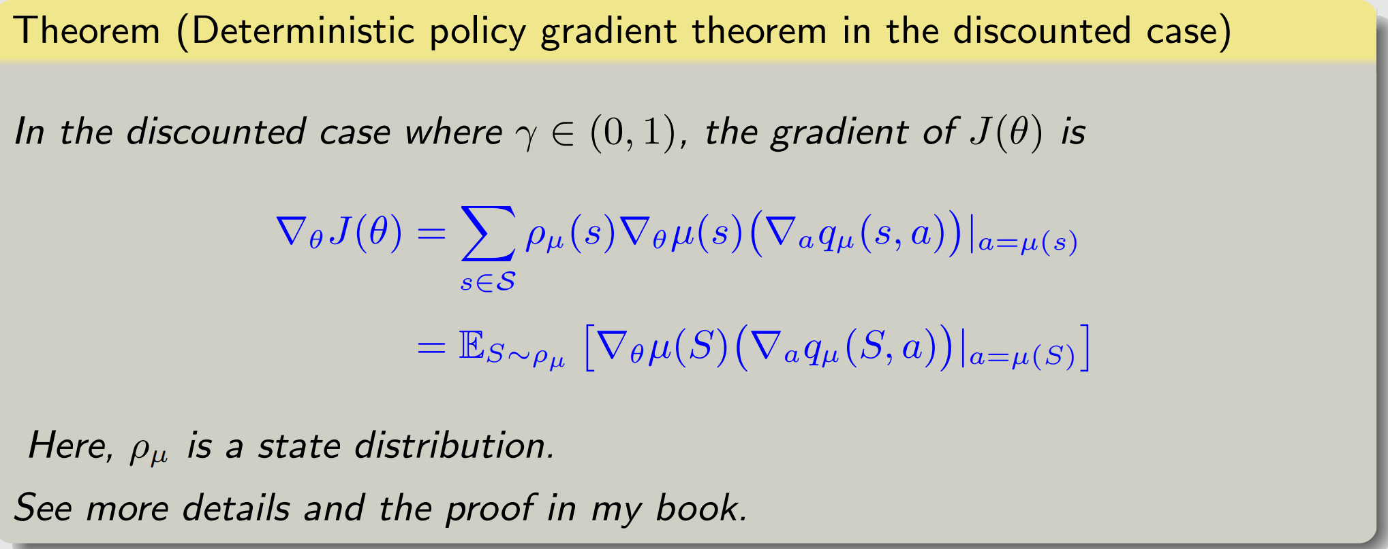
The theorem of deterministic policy gradient
One important difference from the stochastic case:
• The gradient does not involve the distribution of the action A (why?).
• As a result, the deterministic policy gradient method is off-policy.

Slide 40
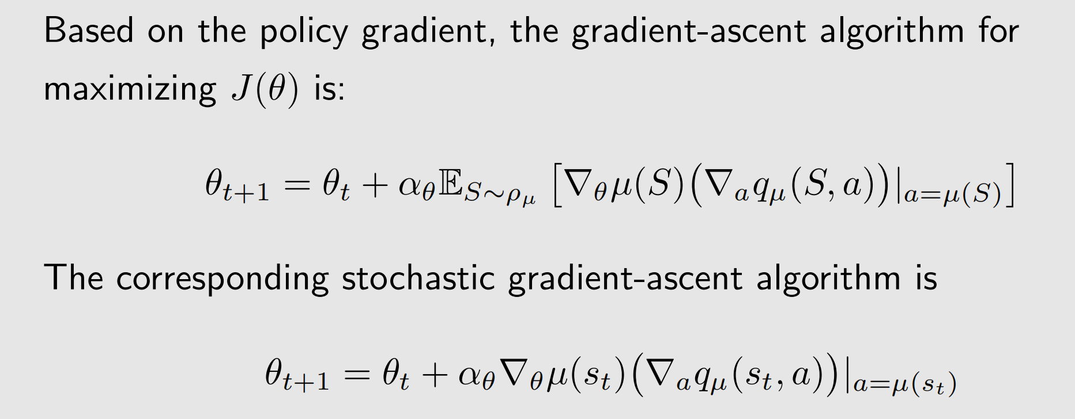
The algorithm of deterministic actor-critic

Slide 41
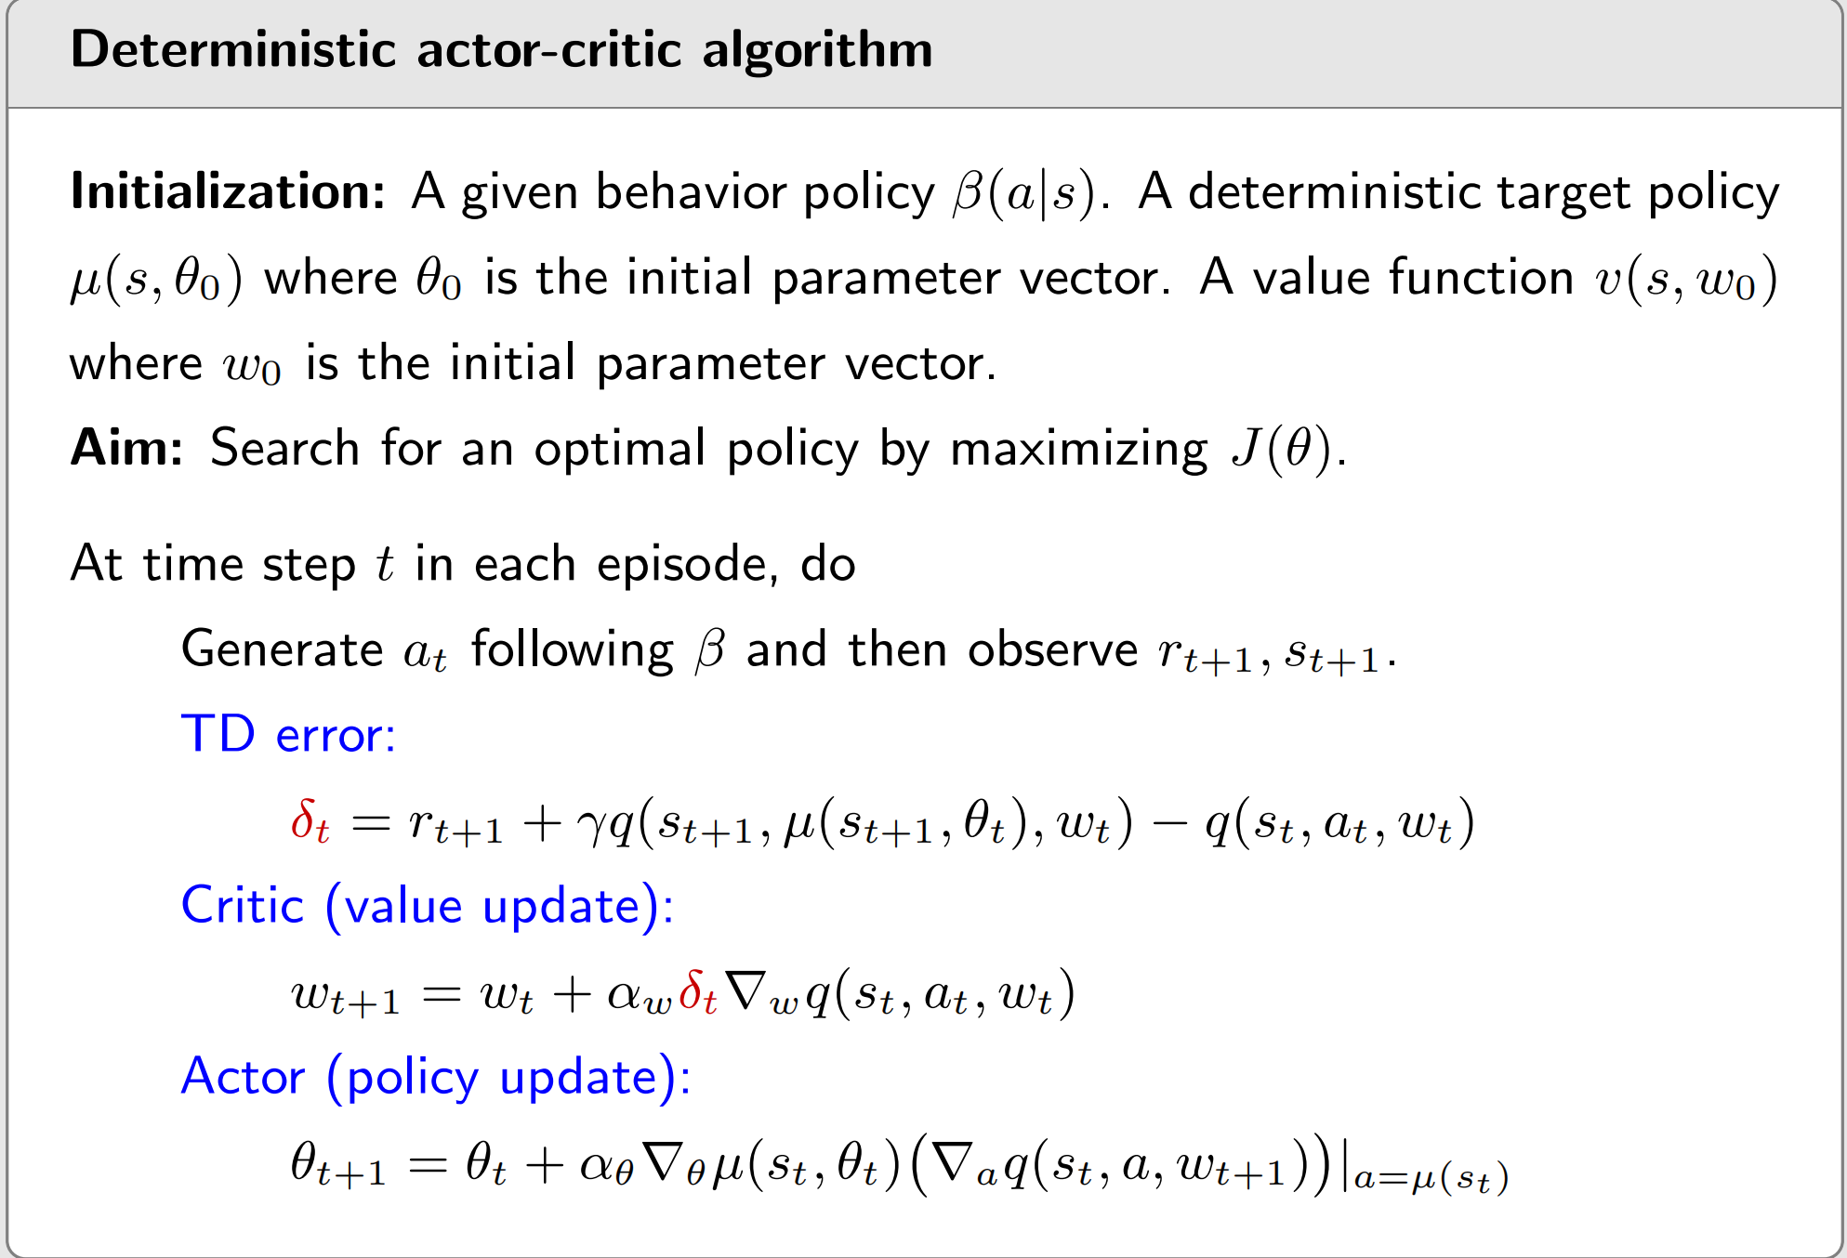
The algorithm of deterministic actor-critic

Slide 42
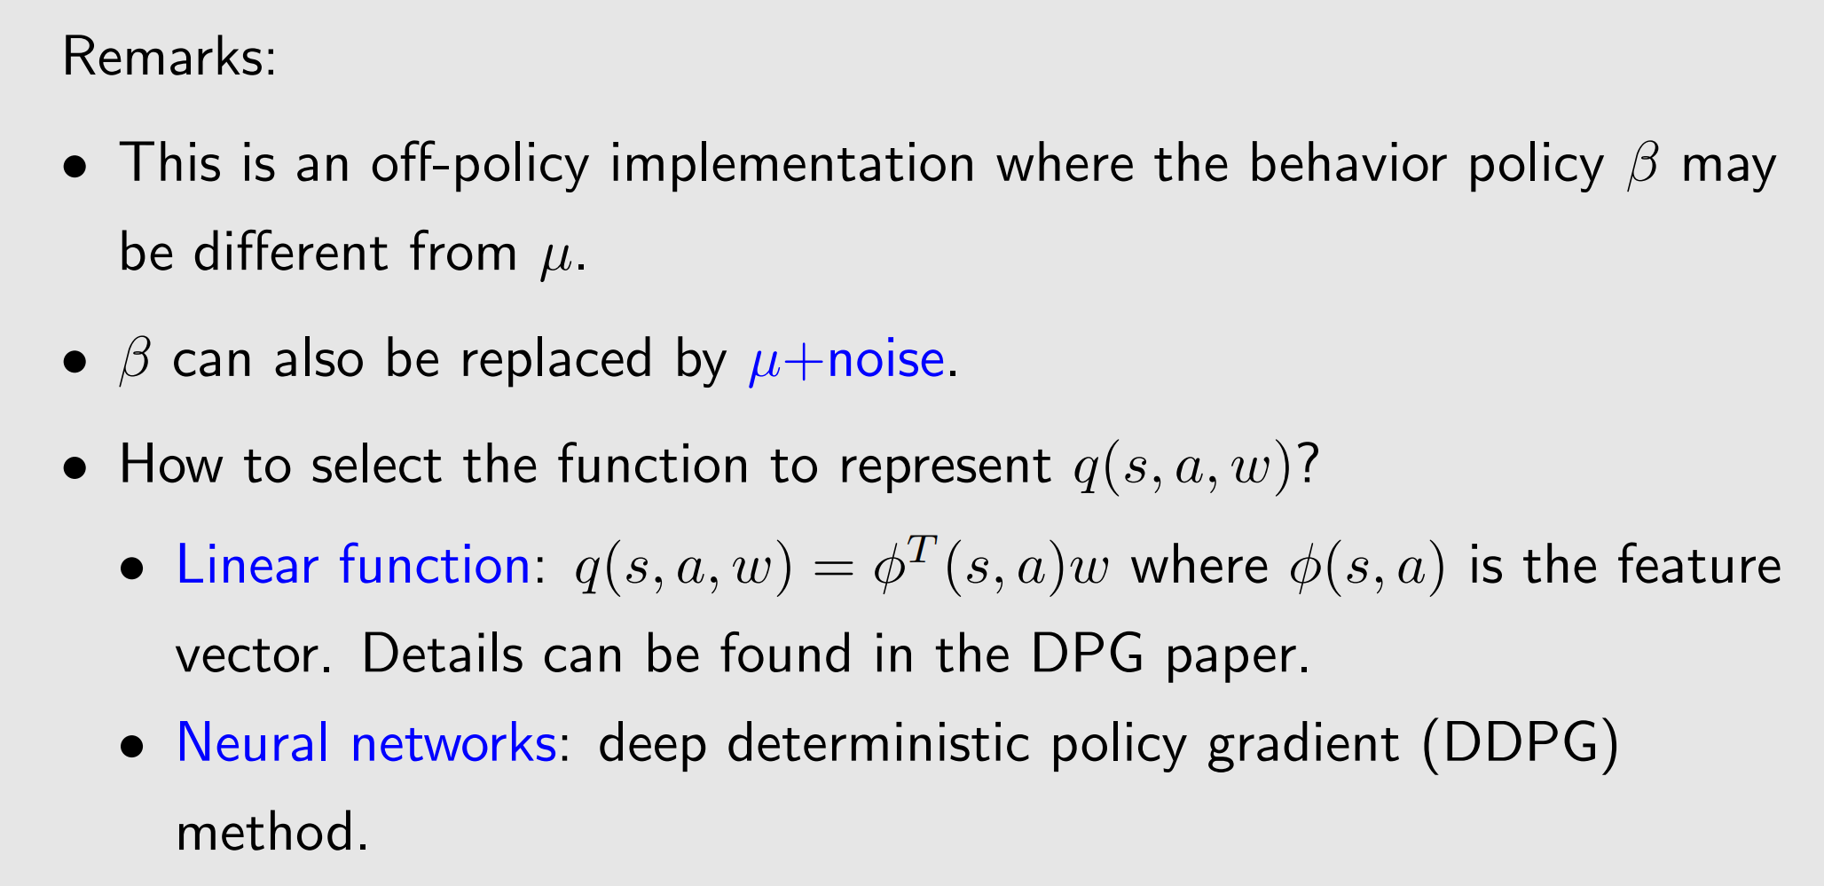
The algorithm of deterministic actor-critic

Slide 43
1
The simplest actor-critic (QAC)
2*
Advantage actor-critic (A2C)
3
Off-policy actor-critic
4
Deterministic actor-critic
5
Summary

Slide 44
Summary
• The simplest actor-critic
• Advantage actor-critic
• Off-policy actor-critic
• Deterministic actor-critic

Slide 45


Any Questions?

